Slide 1
Restoring a Prairie
Day 5

Slide 2
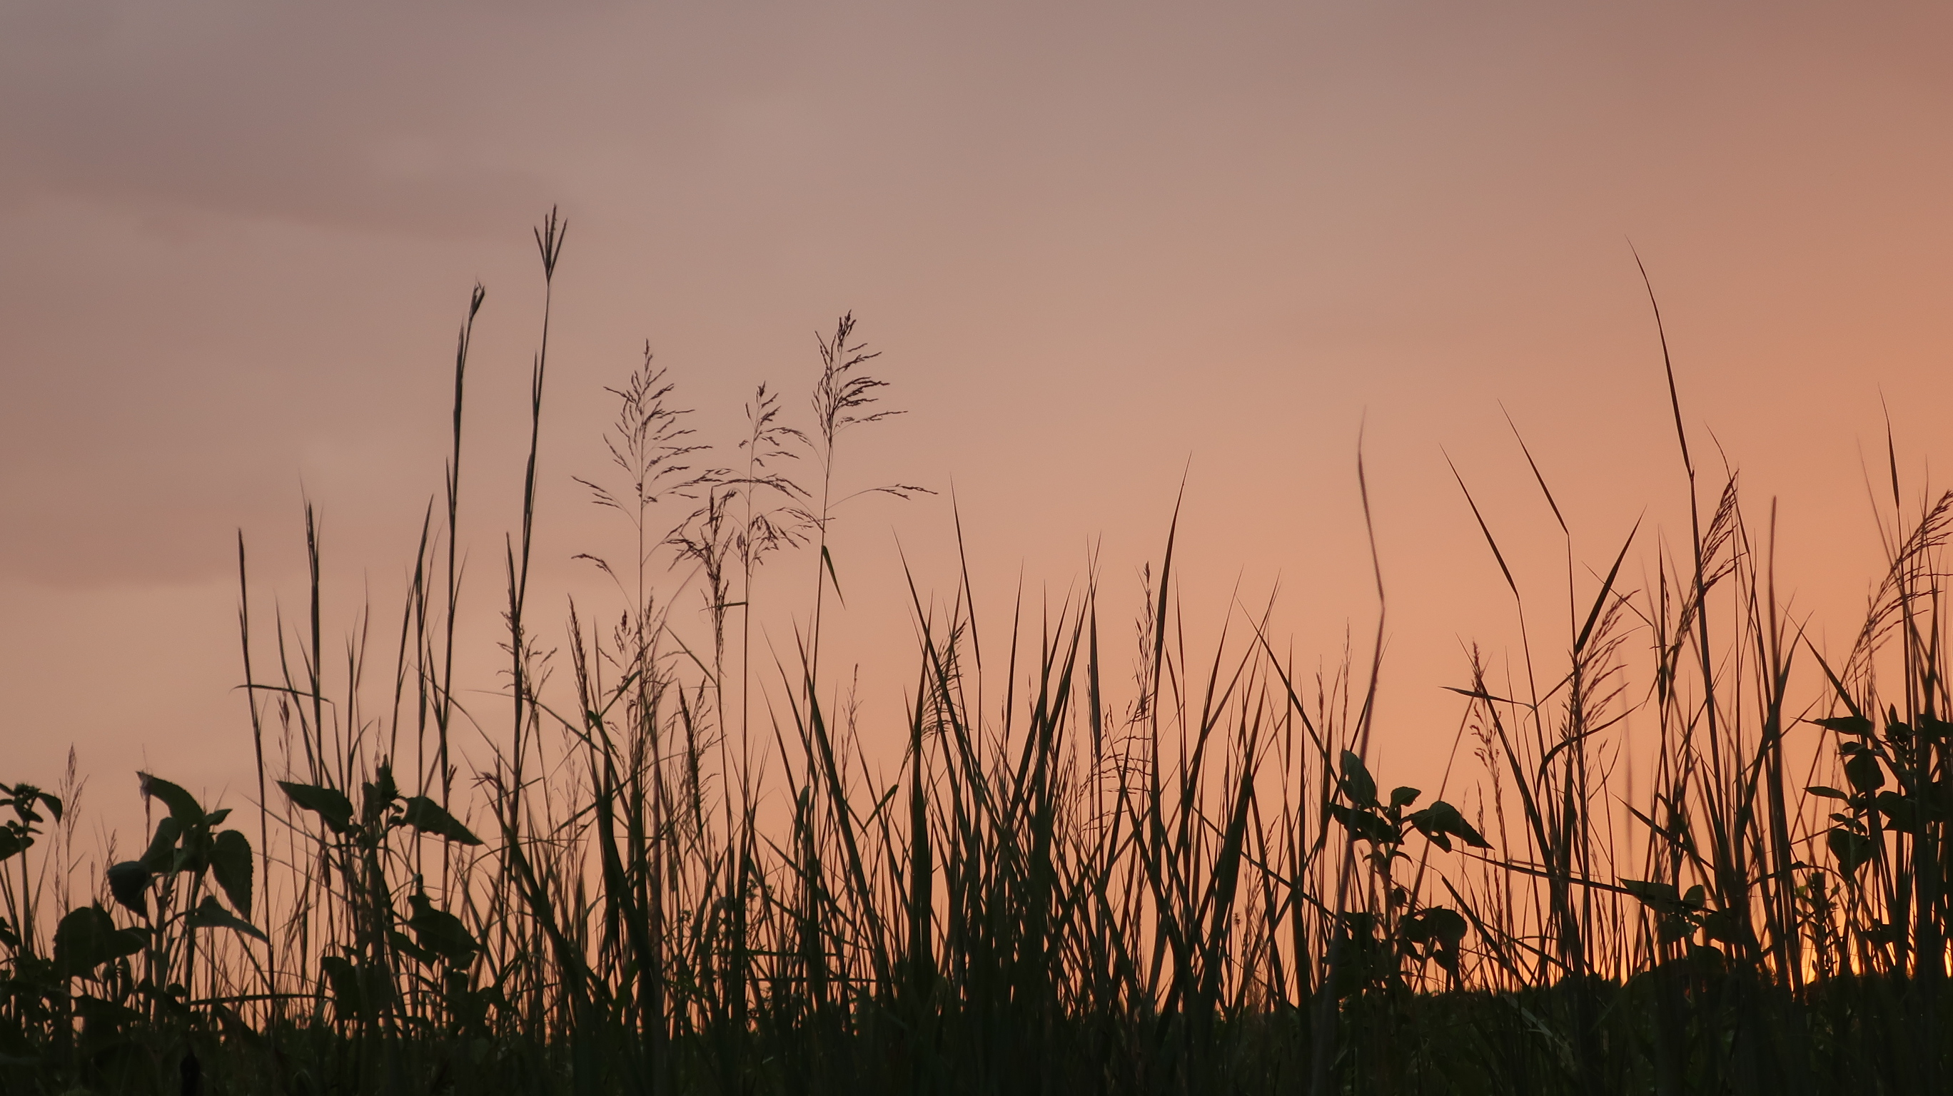
What we know so far…
A healthy prairie has lots of different species of plants and animals.
The health of the prairie can be measured by how much the plants grow and how much weight a grazing animal gains in one year.
Precipitation – rain, sleet, and snow – plays a big role in how healthy a prairie is.

Slide 3
What we know so far, continued …
Prairies must be managed in order to remain healthy.
Controlled burning – use of fire – is the best way to keep a prairie healthy and productive.
Prairie grasses and forbs are adapted for the presence of fire.

Slide 4
What we know so far, continued more…
Fire can help keep woody shrubs from invading a prairie.
If shrubs get big enough and with deep enough roots, they are considered to be “established”.
Established shrubs can absorb lots of water, to the point of keeping water from draining into the creek.

Slide 5
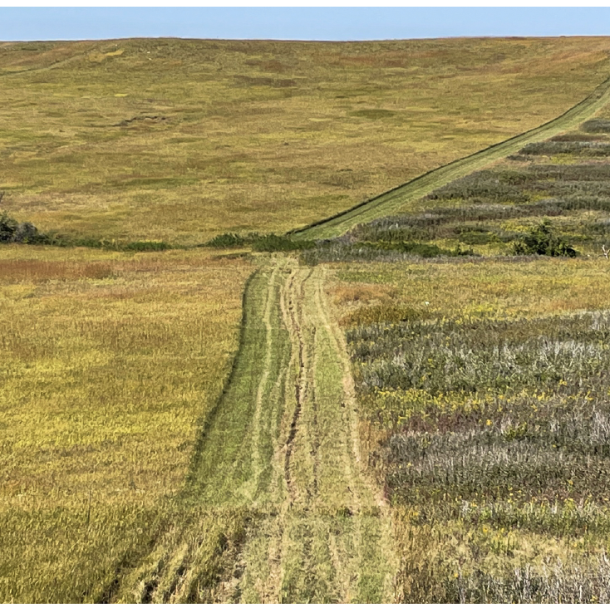
Prairies are in danger of disappearing
Good prairie
Question:
What is causing the prairies to disappear?
Shrub-infested, not really prairie anynmore
Notes:
Answer on the next slide

Slide 6
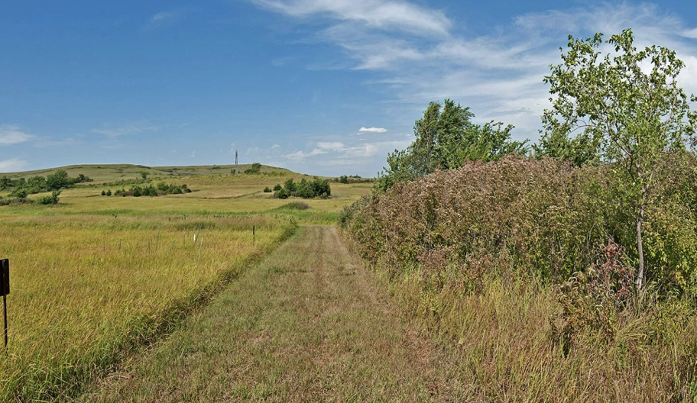
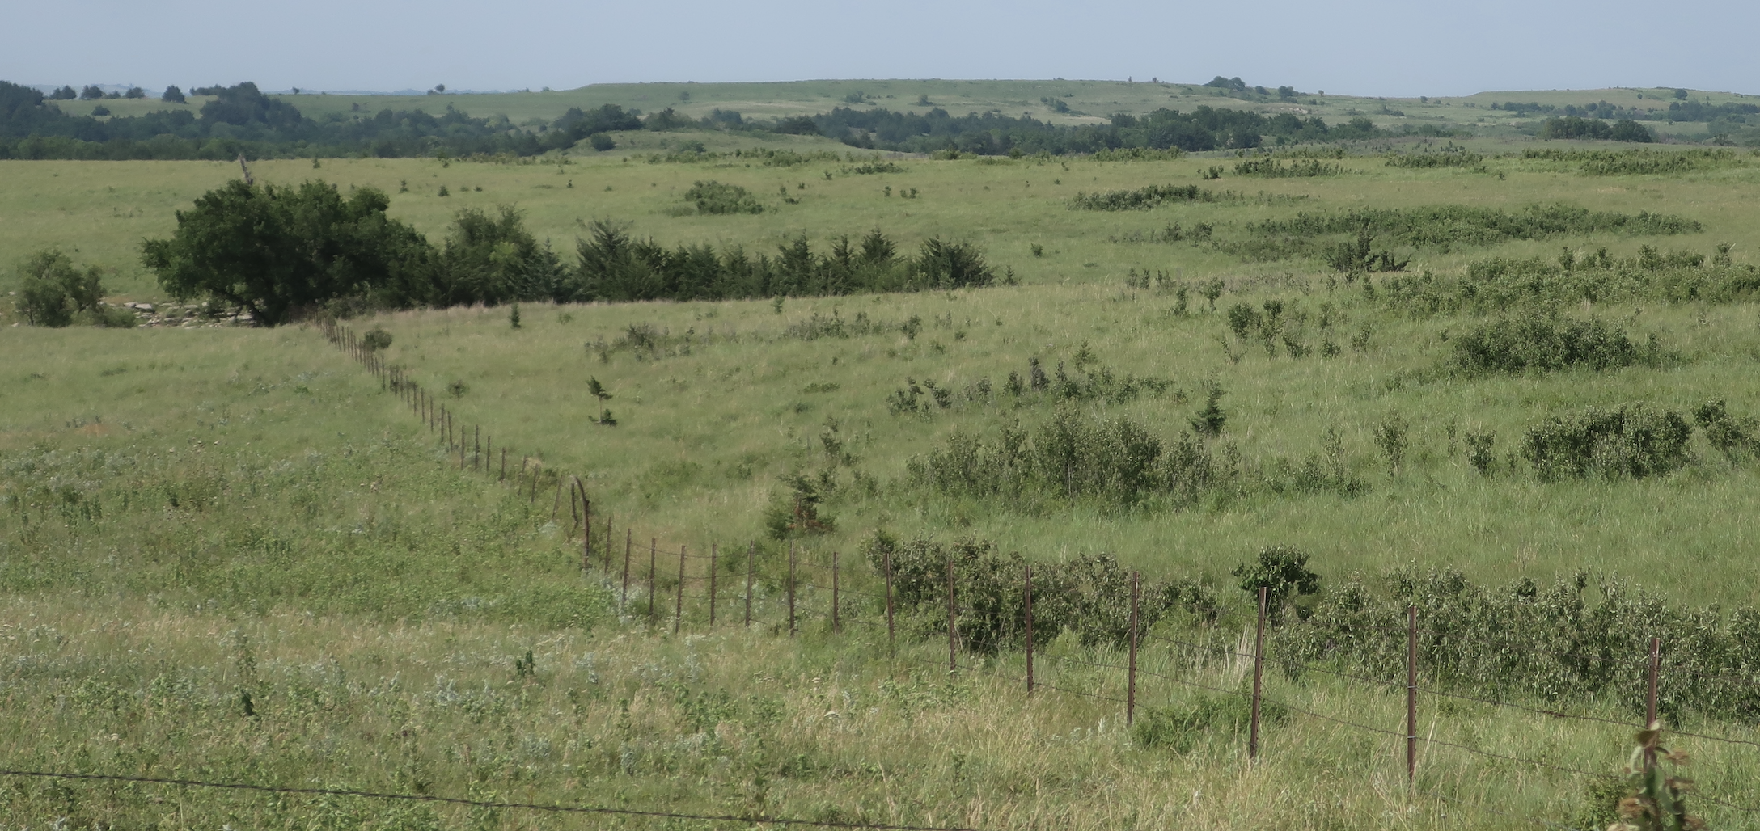
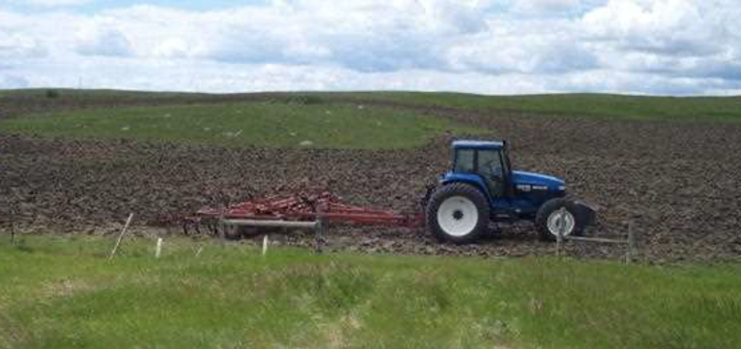
Answers:
There are several potential answers - including:
Woody shrub invasion of prairies that are not burned
Land-owners ignoring their prairie completely (leaving prairie alone = bad!)
Plowing the previously unplowed prairie

Slide 7
Prairies are disappearing…
Question:
Should we care about that?
What are some qualities of prairies that make them worth saving?
Notes:
Possible answers on the following slide, but…
The question about whether prairies should be saved is a mainly a rhetorical one. You can take a lot of time with this discussion. Students may or may not have some strong feelings about this.
One point I would like to emphasize: the prairie is THEIR ecosystem. Whether the prairie endures or not will be something they get to decide.

Slide 8
Why should prairies be saved?
Some potential answers:
They are important for grazing animals
They are the home to many plants and animals that are not found anywhere else
They are important stop-over places for migrating animals, like Monarch Butterflies
They are very important ecologically
The prairie is YOUR ecosystem!

Slide 9
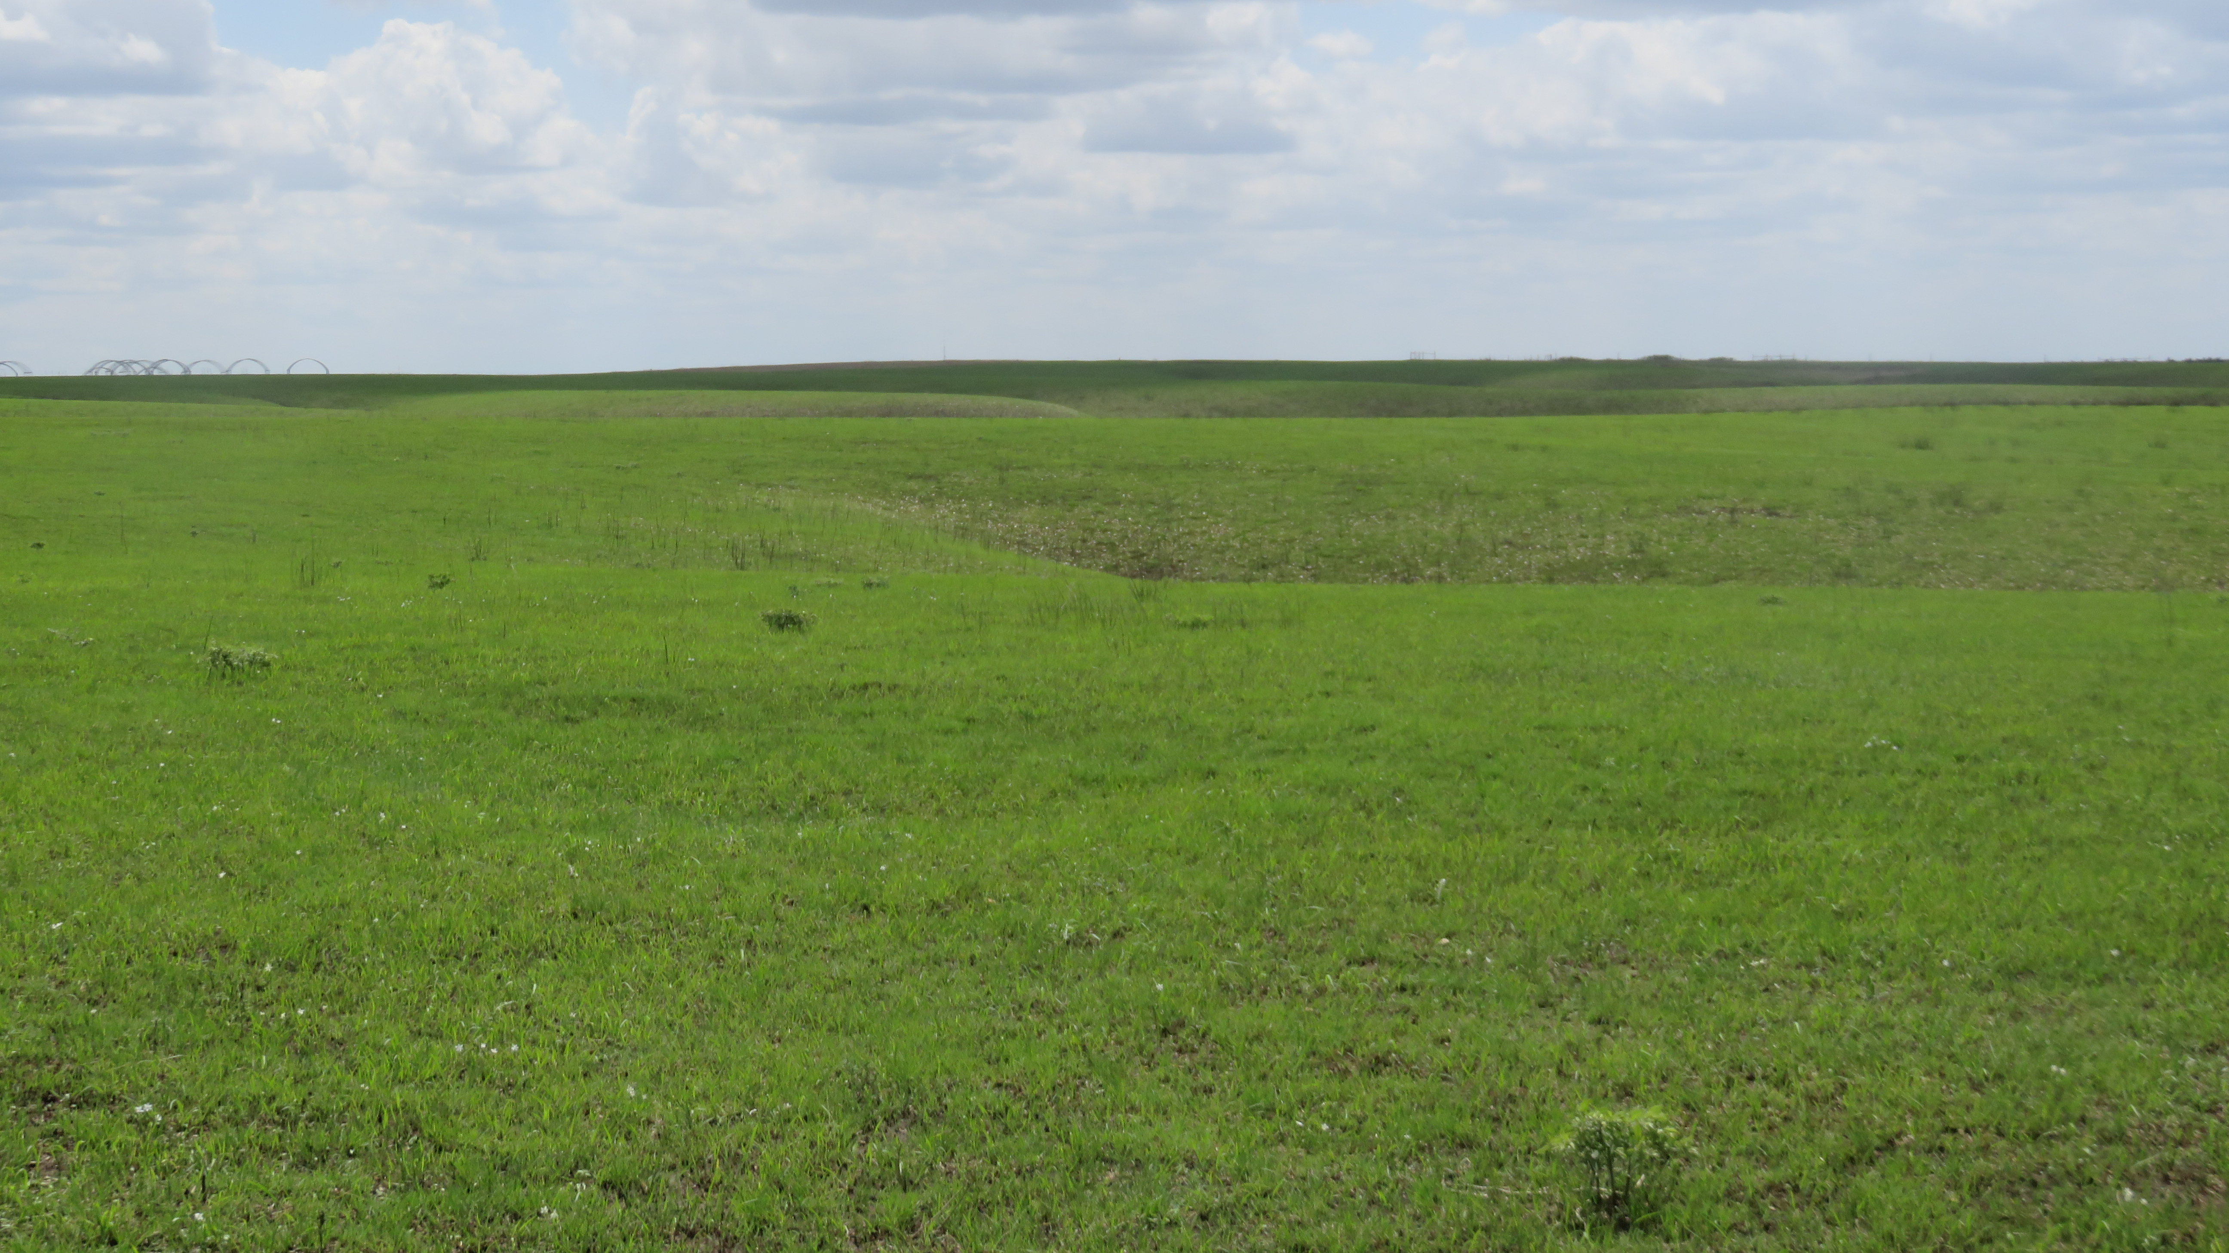
Let’s understand how a healthy prairie works

Slide 10
Recall that most of prairie life is under the ground…
Under the ground is where the heart and soul of the prairie ecosystem may be found.
If the first 12” of soil (= the “sod”) is damaged/destroyed, then the prairie is destroyed.
That tangle of roots, stems and animals living in that area took hundreds of years to form. It’s really hard to make it again once it’s lost.

Slide 11
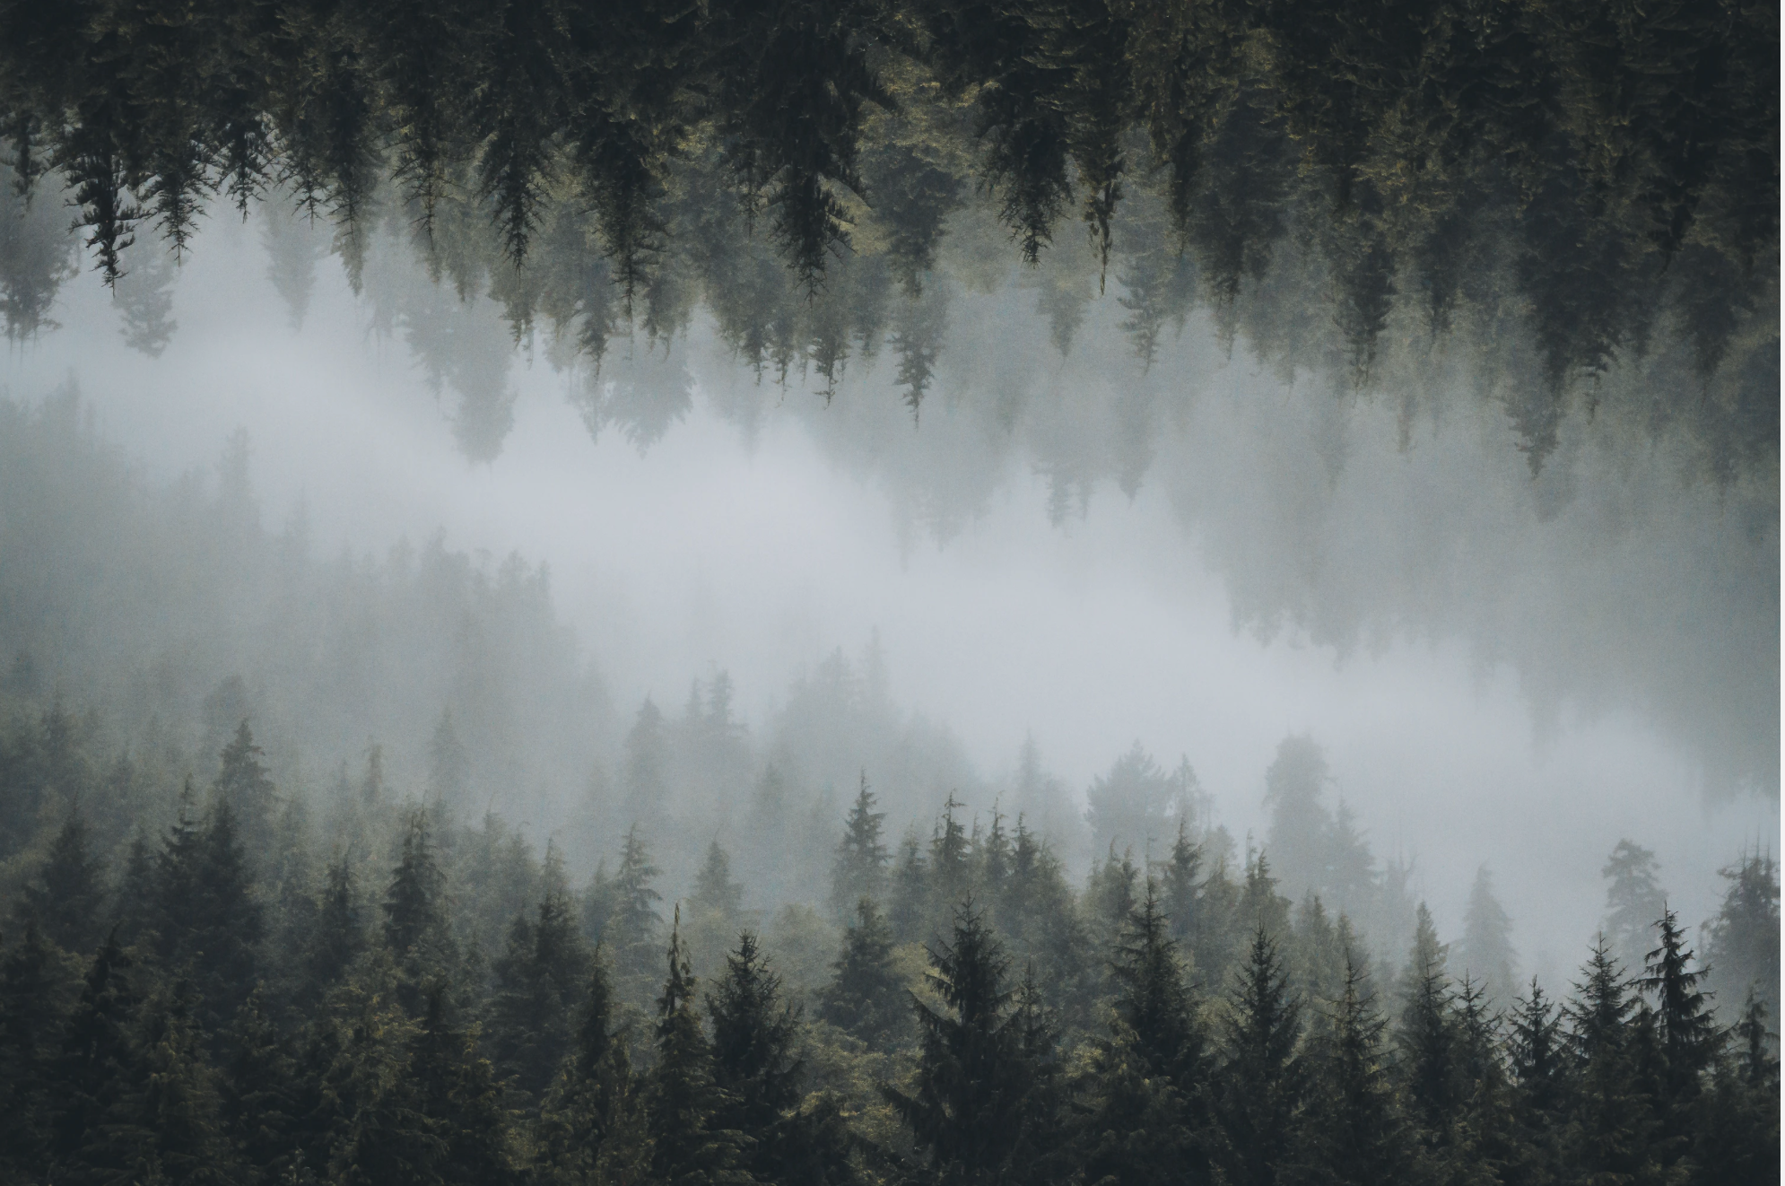
Prairies are important storehouses for carbon
A prairie is kind of like an upside-down forest.
Where forests of trees have most of their bodies located above the soil…
Prairies of grasses and wildflowers have most of their bodies located underground.

Slide 12
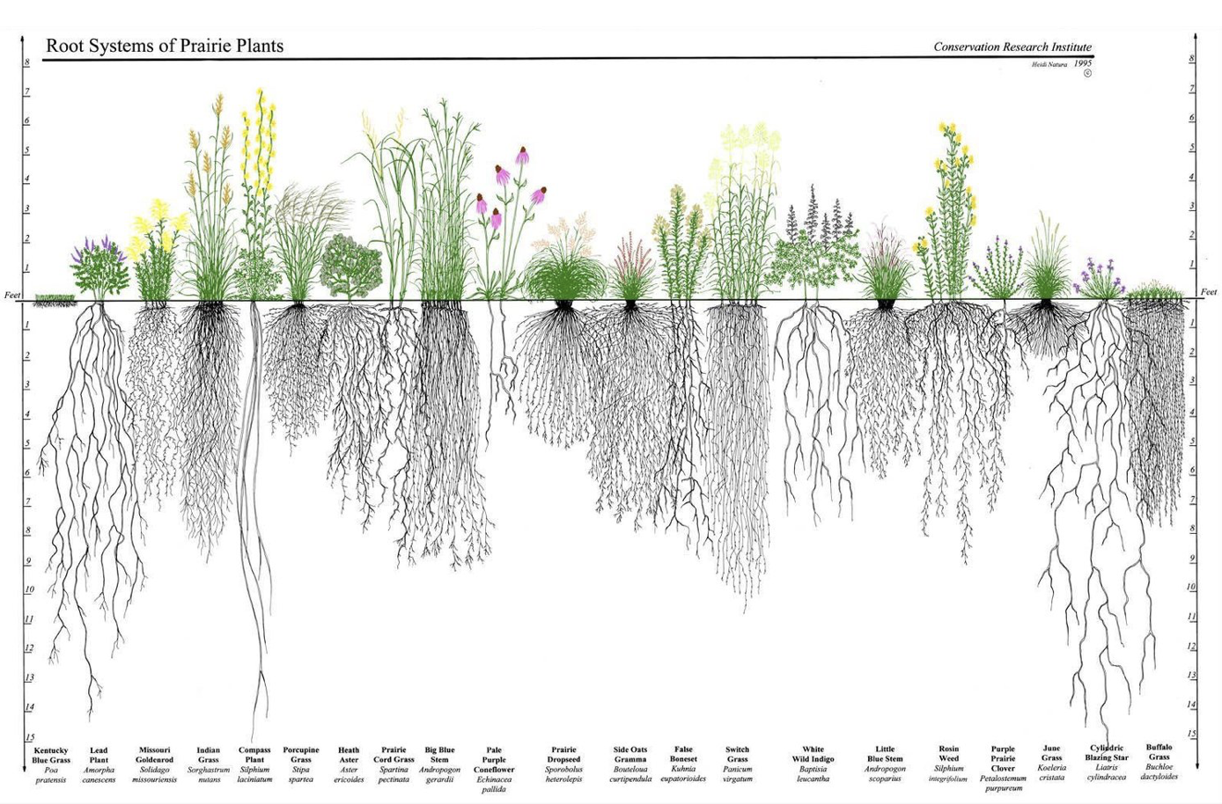
All of those underground structures in a prairie are full of carbon
If the stems and roots of the prairie soil are destroyed, a lot of the carbon that was stored is released into the atmosphere.
BUT in prairie restoration…
Making new prairies is a great option in the war against climate change. The growing new plants help to move CO₂ from the atmosphere to the prairie soil.

Slide 13
BUT – Can a prairie be “restored”?
Question:
Can we take land that as once a plowed field of corn or soybeans and convert it back to prairie?
Answer: Yes – BUT it takes a long time.
These kids are walking in a prairie that was restored 25 years ago

Slide 14
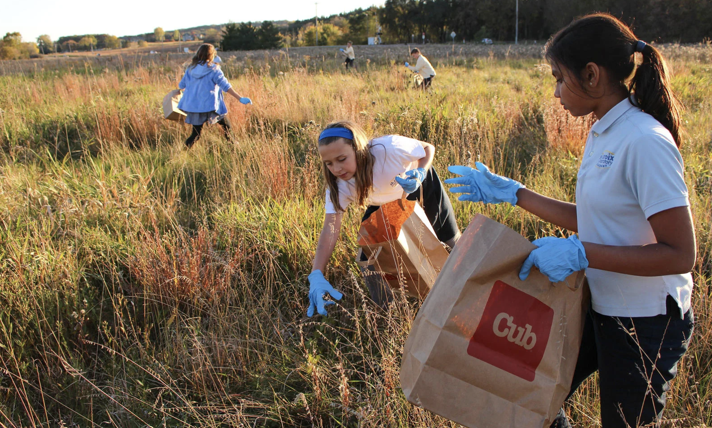
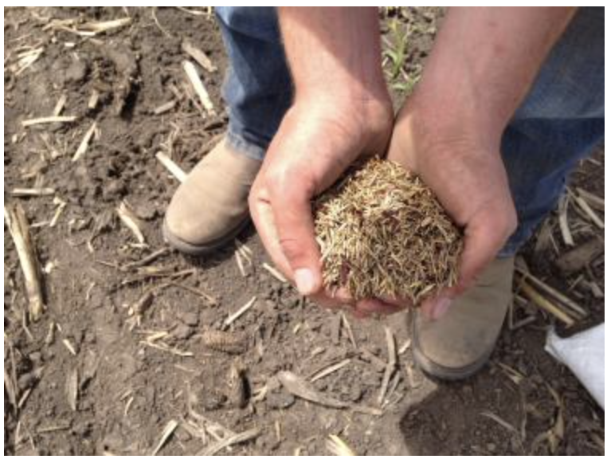
A new prairie can be made…
Prairie seeds need to be gathered
Seeds are sown (planted) - usually in the autumn
New prairie plants begin to grow in the spring

Slide 15
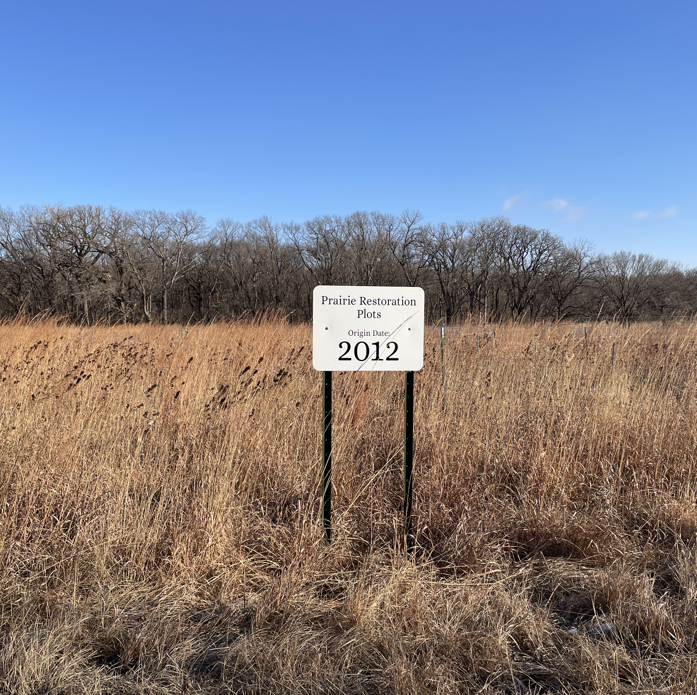
But it takes a LONG time for the prairie to return
We’re not sure how long
It’s probably over 100 years for the full prairie to return once it is re-seeded.
The prairie has lots of interactions between the plants and the animals and it takes time for the interactions to re-form.

Slide 16
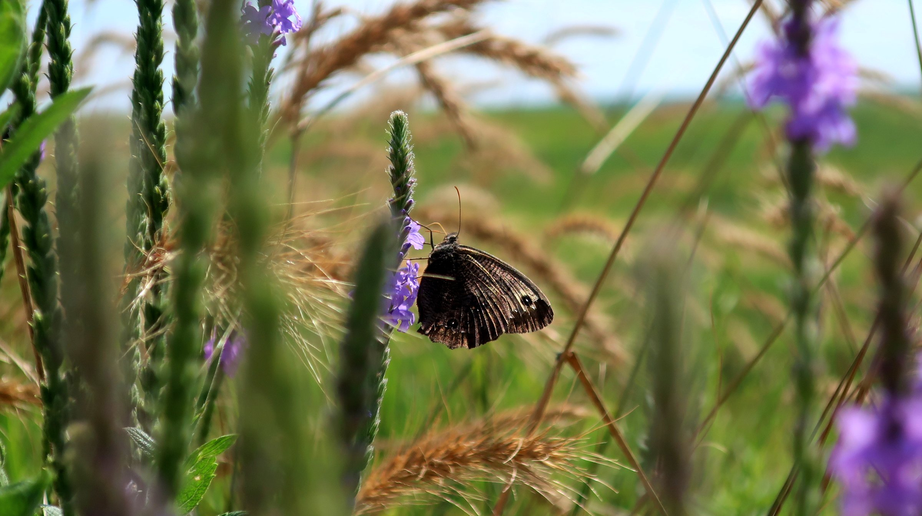
Prairies are complex places!
It takes a long time to get all of the different parts back when we try to restore prairies.
Prairies have:
Grasses
Forbs/Wildflowers
Mammals
Birds
Insects
Fungus
Worms
Bacteria

Slide 17
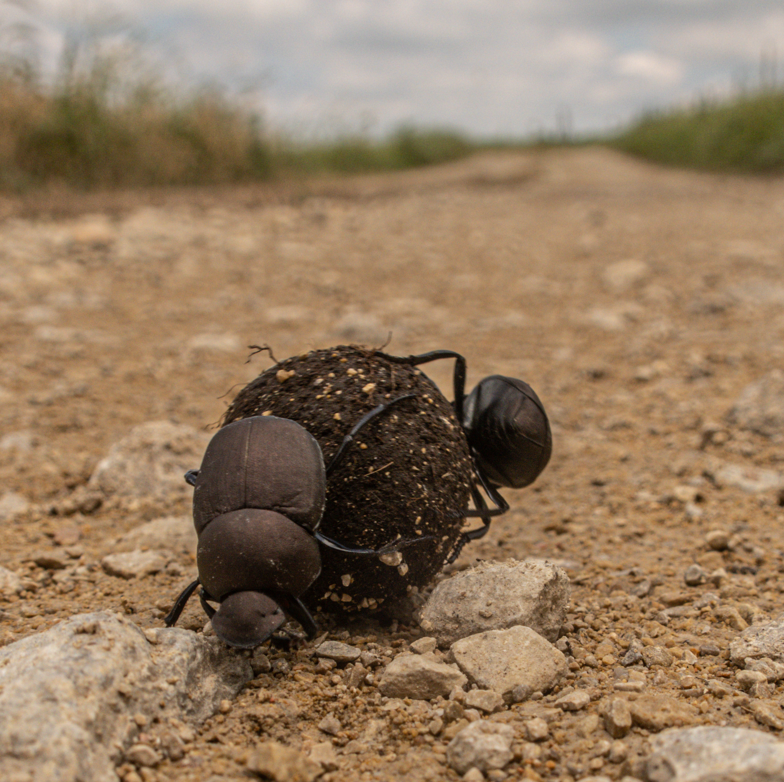
Healthy prairies have biodiversity
BUT – once all of those different species have been removed, it’s hard to get them back.
Each species plays a role…

Slide 18
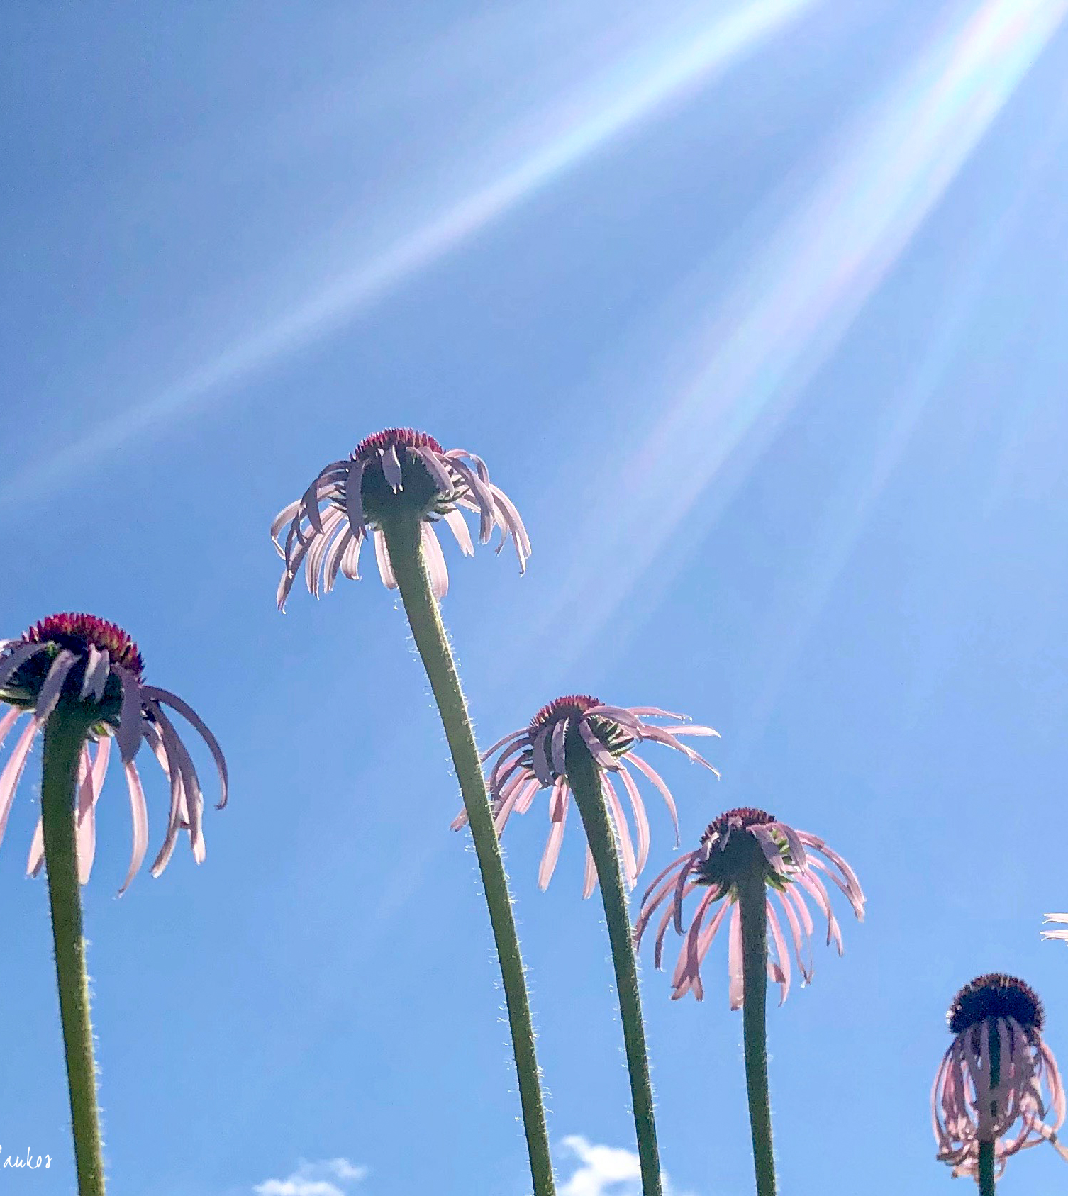
Each different species in an ecosystem has a role
Every species is trying to survive and to reproduce
If they are a plant, they are seeking sun, water, and soil nutrients
If they are an animal, they are seeking food, shelter, and territory

Slide 19
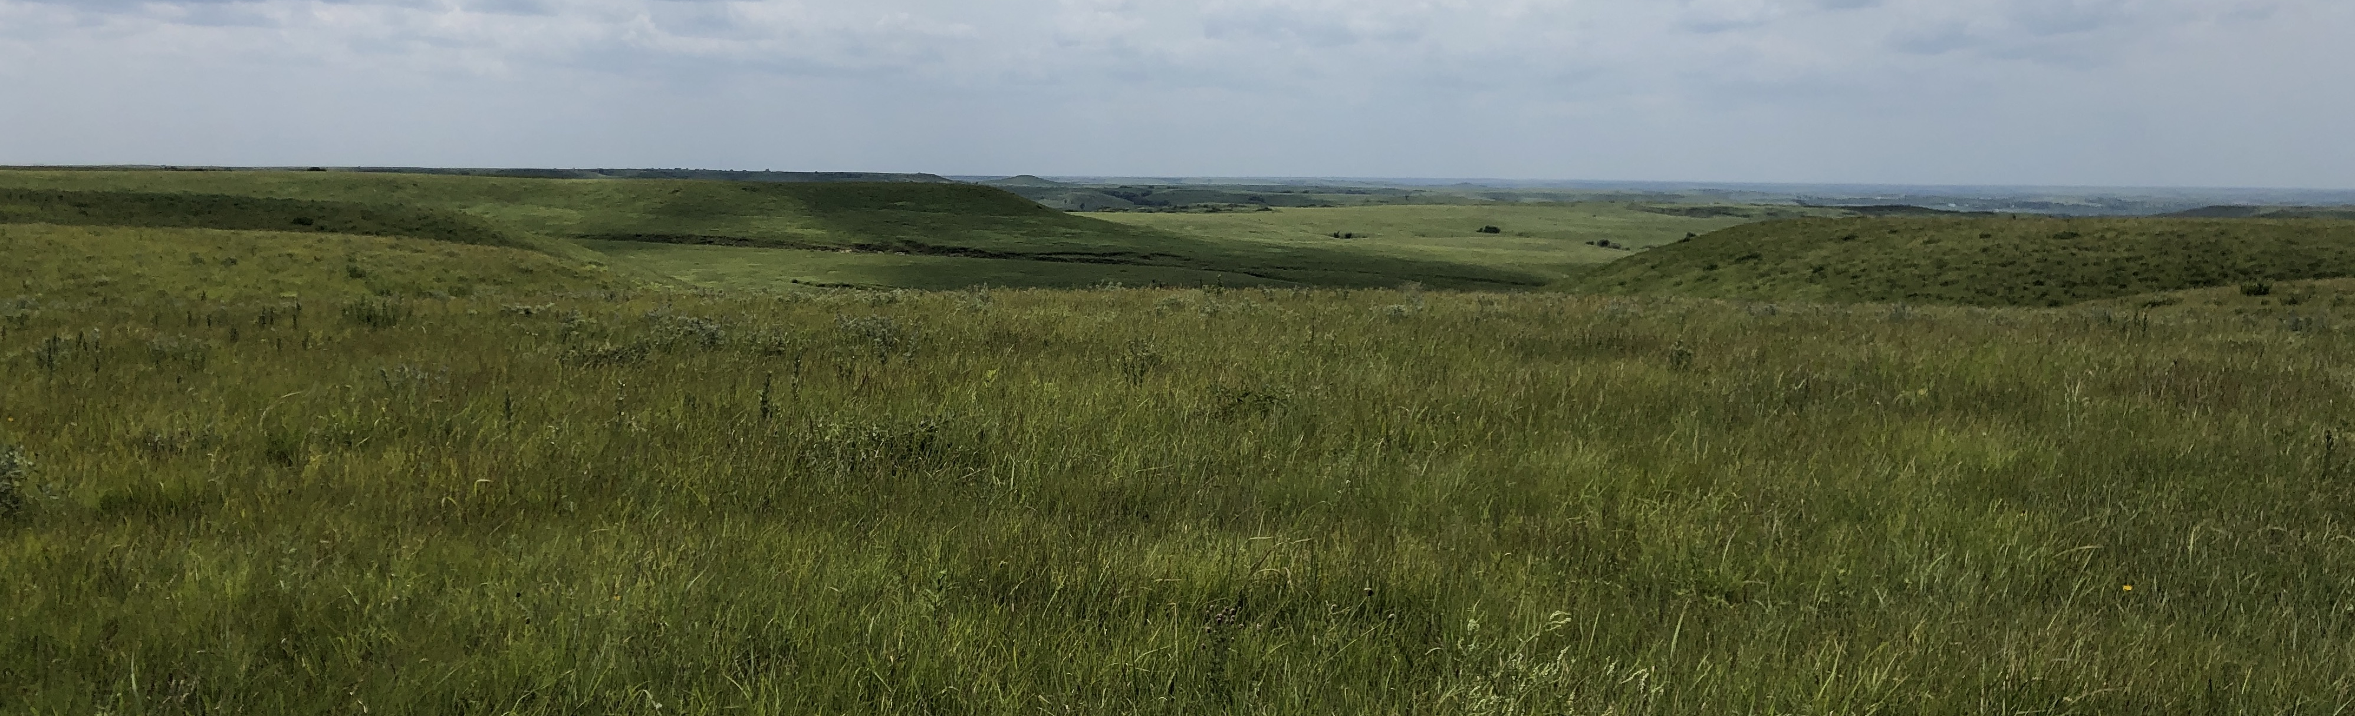
The Food Chain…
Every member of the ecosystem has some way of getting its food.
Organisms either eat or they make their own food.

Slide 20
“Trophic levels” = describes how an organism gets its food
Plants are “Producers” – they make their own food – by photosynthesis. They take the sun’s energy and captures it in chemical bonds that combine carbon, hydrogen, and oxygen together into sugar molecules called “glucose”.
Animals that eat the producers – and get energy from eating the glucose – are called “Consumers”.
Organisms that feed off of the bodies of dead plants and animals are called “Decomposers”.

Slide 21
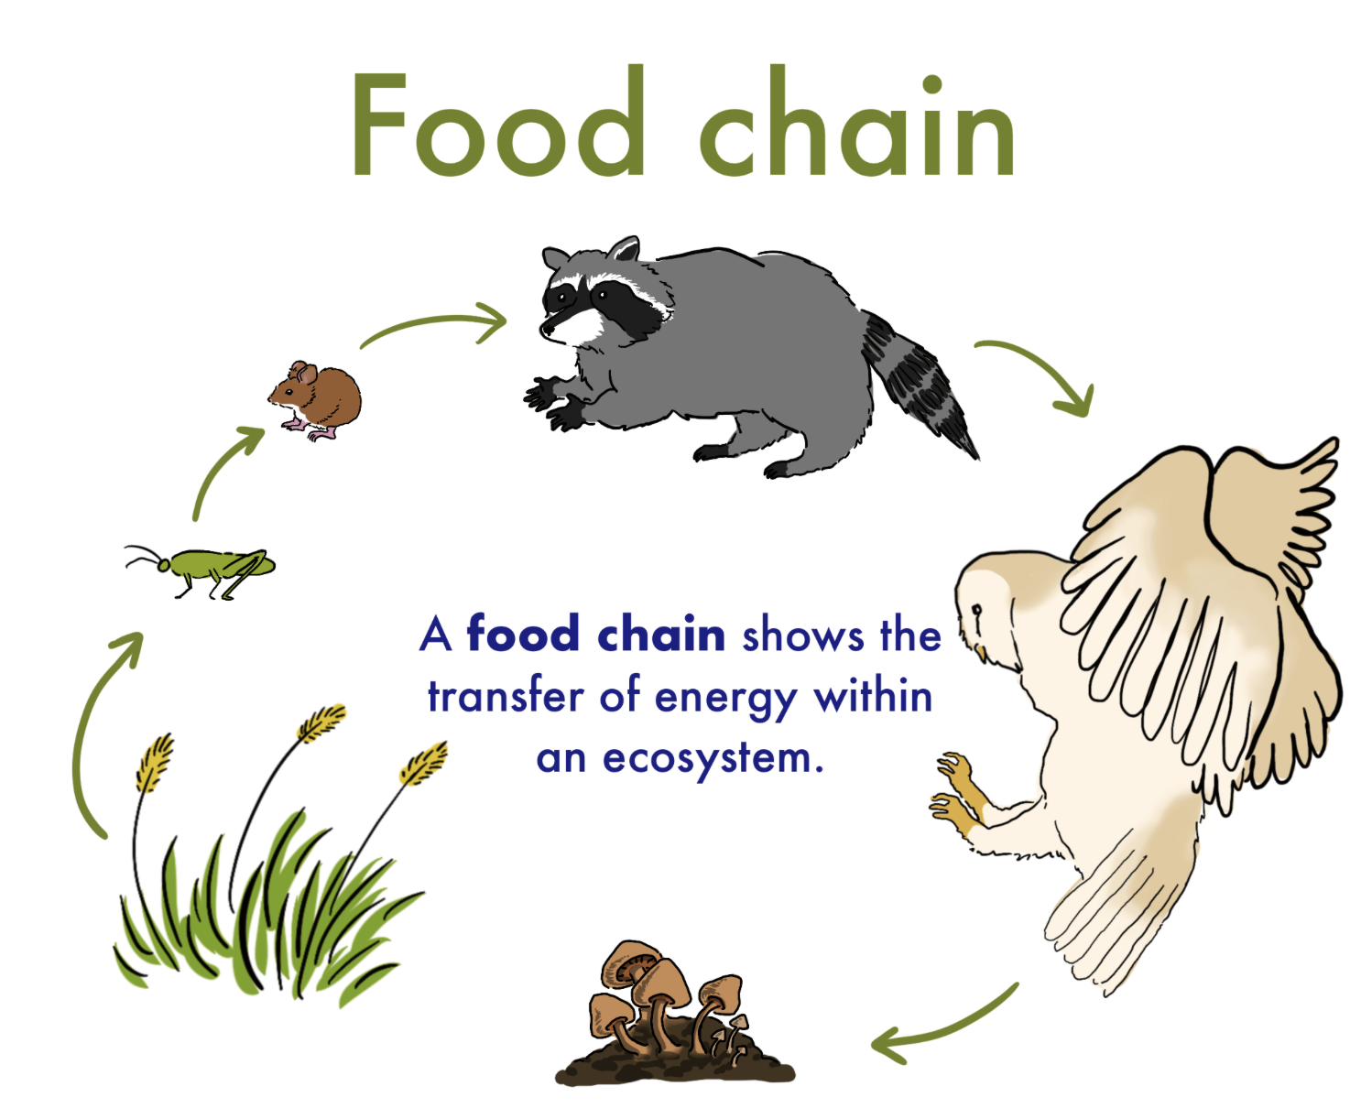
A simple food chain looks something like this…
Consumer
Consumer
Consumer
Consumer
Producers
Decomposer

Slide 22
But, the ecosystem is more complex
There’s not just one animal that eats the grass, but many different animals.
There isn’t just one kind of insect that pollinates the flowers, but many different insects.
A more correct image of the flow of energy through an ecosystem is a “Food Web”

Slide 23
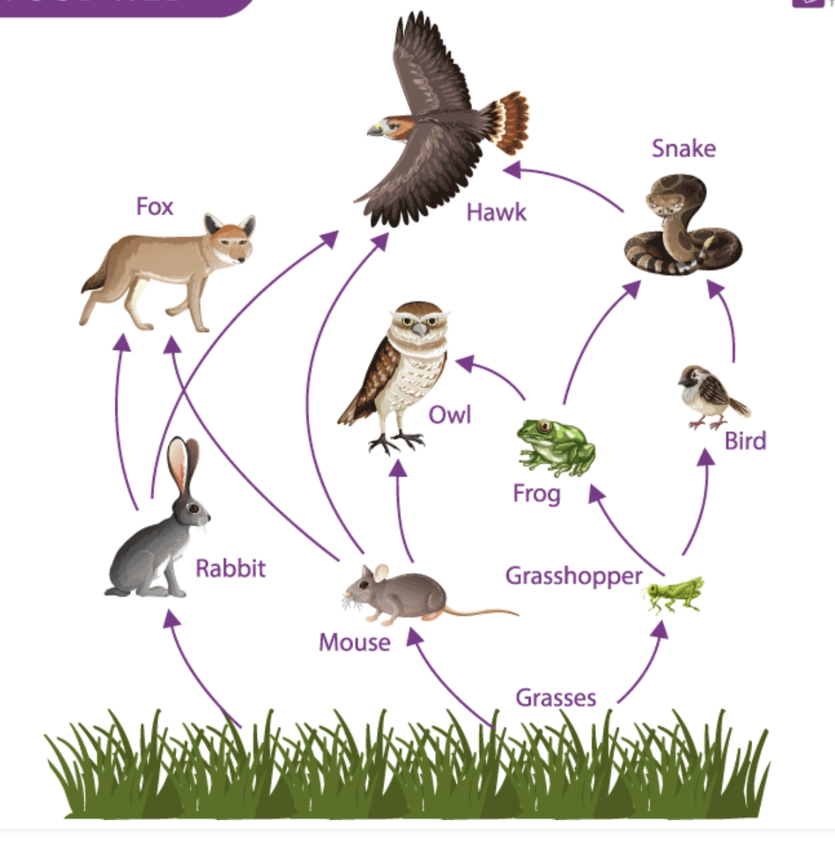
Food Web
BUT – we’re missing an important consumer of the prairie ecosystem!

Slide 24
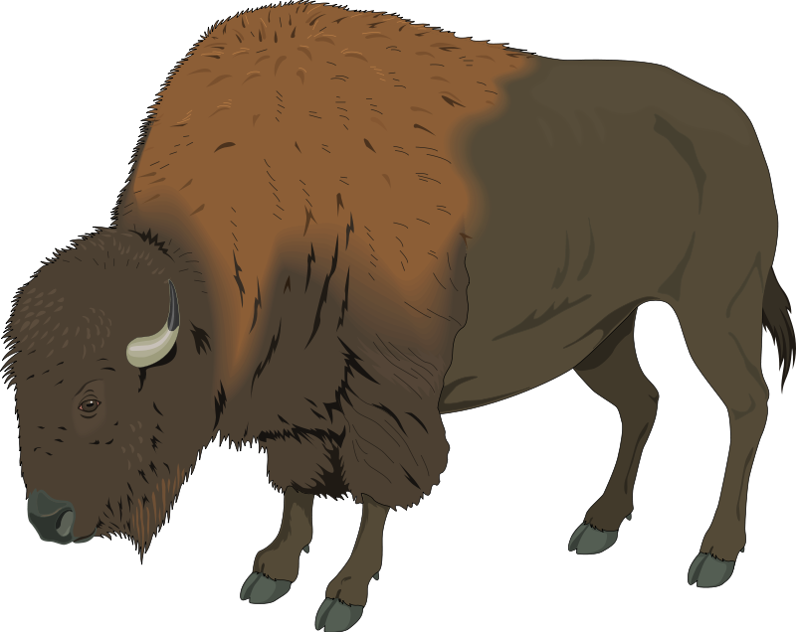
Bison!
Bison would be here:

Slide 25
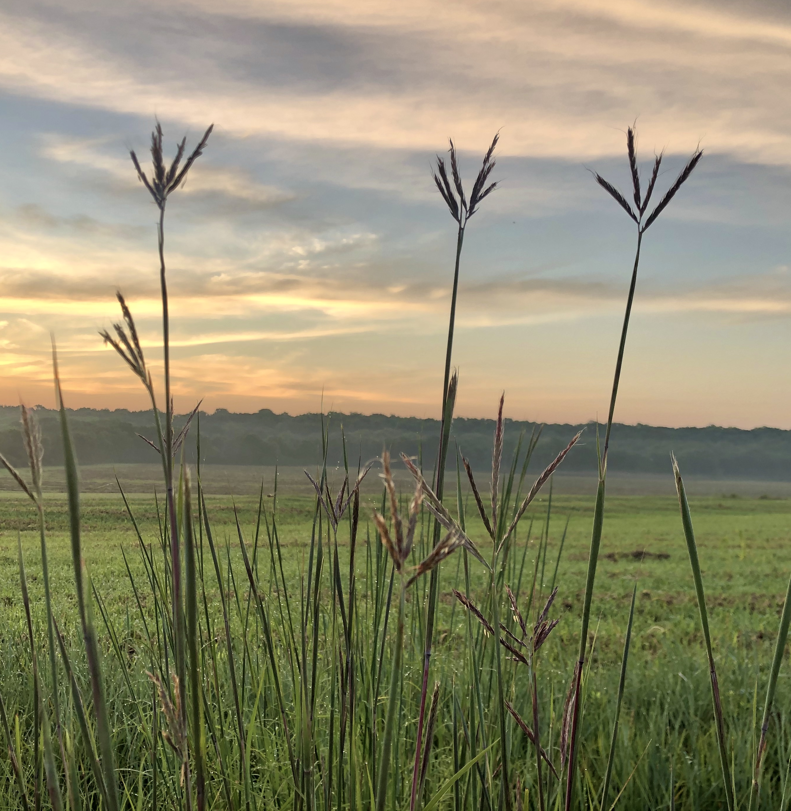
Some plants or animals – exert so much influence on the other species as to be considered “dominant”
Question:
What group of producers (plants) do you think is dominant in a prairie?
Why do you think they’re dominant?
Notes:
Answer on the next slide – do they really not know???!!! :D

Slide 26
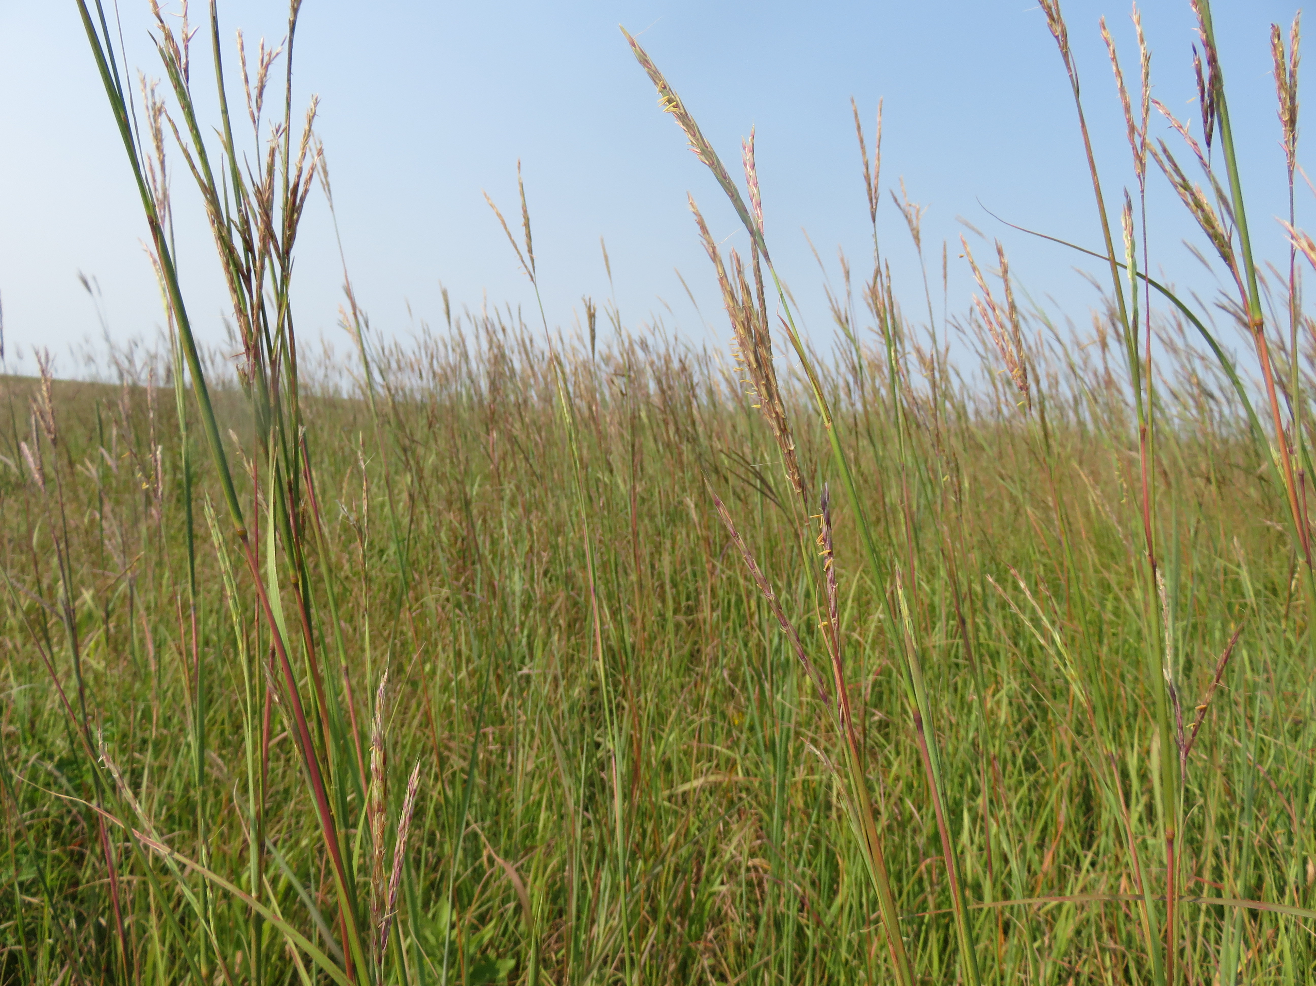
Answer:
Grasses are the dominant producer on the prairie.
Why?:
Super efficient absorbent roots
Underground storage rhizomes
Grow tall – shading out the competition
Adapted for surviving droughts

Slide 27
Question: In a prairie food web, there is a consumer that can control the dominant tallgrasses in an ecosystem. Who is it?
Hint – They eat the grasses, keeping them short.

Slide 28
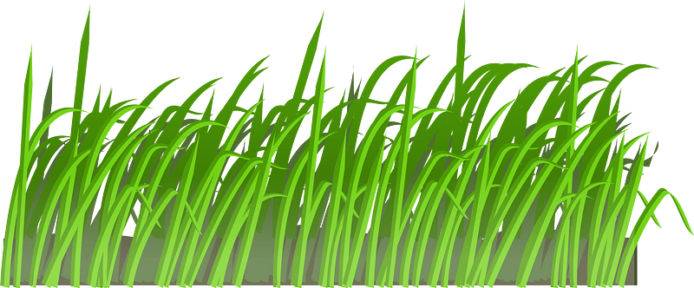
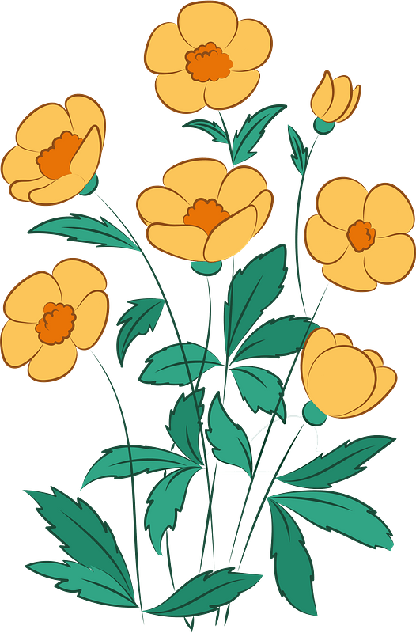
When bison are present, they keep the tall grasses short – by eating them.
Because the dominant grass gets grazed down, the forbs get a chance to grow – and attract pollinators.

Slide 29
In areas where there are bison present, there are a LOT more flowers and insects pollinating those flowers.
The presence – and absence – of bison affects just about every species on the prairie.
We’ll talk more about the role of bison on the prairie in the high school curriculum.

Slide 30
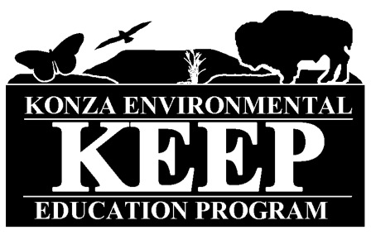
Author:
Jill Haukos
Konza Environmental Education Program
Konza Prairie Biological Station
Manhattan, KS
© 2023

