Slide 1
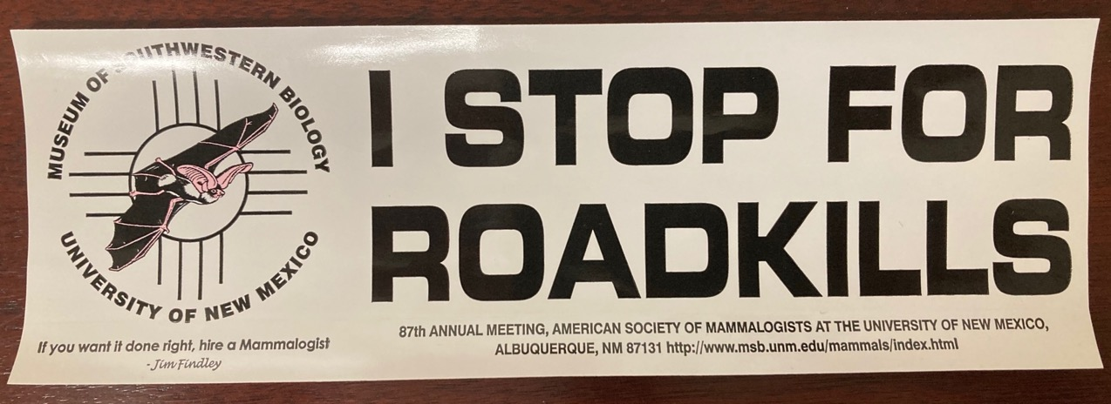
A New Naturalist’s Motto?

Slide 2
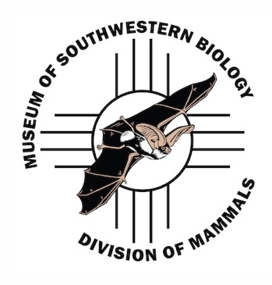
Kansas Master Naturalists Course Mammalogy – 3 April 2021
Andrew G Hope – K-State Biology, since 2014
BSc. University of Glasgow, Scotland
MS. Eastern New Mexico University, Portales, NM
PhD. University of New Mexico
Museum of Southwestern Biology
Extensive work with mammals since 1997
Out of last 24 years, only 3 have not involved at least 1 month of fieldwork, mostly consisting of remote expeditions.
Discovery, Natural History, Museum Science, Evolution-based Conservation, Management of mammalian wildlife

Slide 3
Broad overview for today
Trapping – Fieldwork!
History of Mammal Naturalists (mammalogists)
Natural History of Mammals
Methods for observing mammals
Mammals at risk in Kansas
Methods for identifying mammals

Slide 4
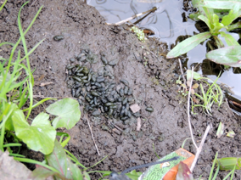
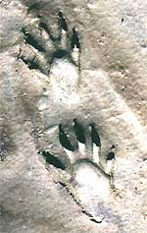
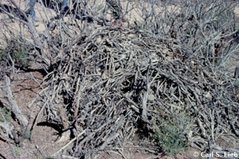
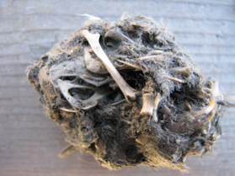
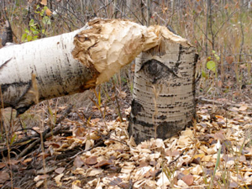
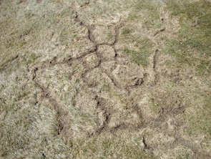
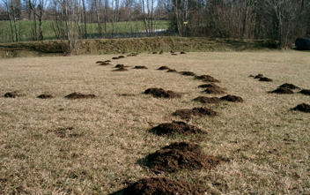
Methods for observing mammals
Binoculars? Yes, but not the main way…
Find mammal parts/sign and identify them.
Traps - Most mammals need to be caught to be observed.

Slide 5
Trapping
Traps set
Sherman live traps (~80)
We’re going to check and collect traps
Must be timely
Morning heat can quickly stress or kill animals
Fold empty traps after dumping bait
Label and gather closed traps
Show-and-Tell

Slide 6
Let’s Go!
Latex gloves if you would like
Pencils for labeling
Trap bags
Don’t handle traps if you have nut allergy

Slide 7
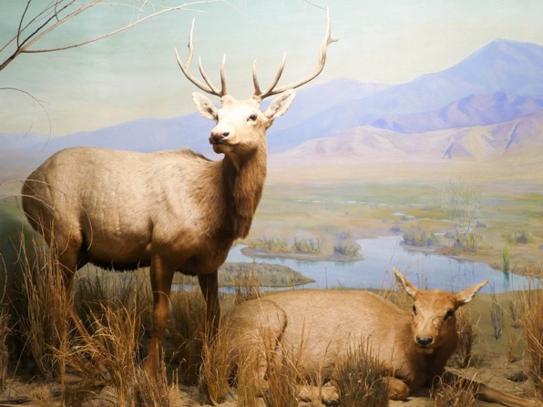
Mammalian Natural History
Natural History is an observational science
Very important!
Link a given species with it’s surroundings
Habitat
Community
Life History Strategy
We can make predictions about what species occur where, based on knowledge of these associations
Pay attention to details
Record your observations

Slide 8
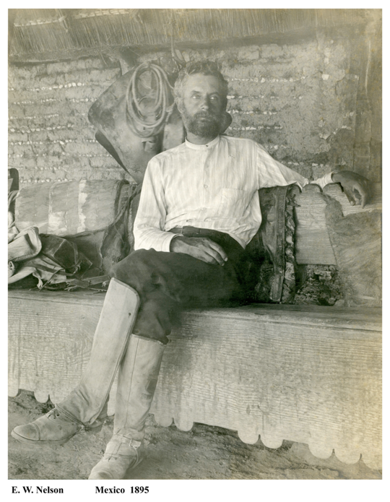
History of Mammalogy in North America
Mid- to Late-1800’s – Discovery Phase
Physician Naturalists of the US Army Med Corps
Described diversity as taxonomists
E.W. Nelson
14 year field trip through Mexico!

Slide 9
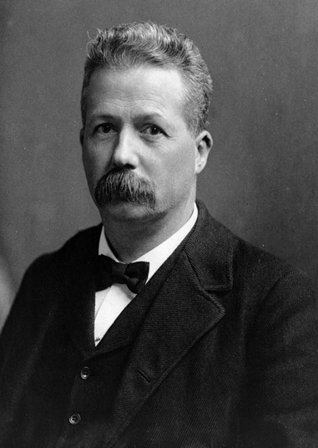
History of Mammalogy in the U.S.
Discovery → Natural History phase in early 1900’s.
Relating species to each other, to their environment, and to their location (systematics, ecology, biogeography)
C. Hart Merriam
1888, Division of Economic Ornithology and Mammalogy
1905, this became the Bureau of Biological Survey
1919, CHM founded the American Society of Mammalogists
“Key to advancing systematics [knowledge] of mammals is to obtain and study large series of uniformly prepared specimens…”
He refined and standardized field and museum methods still used today.

Slide 10
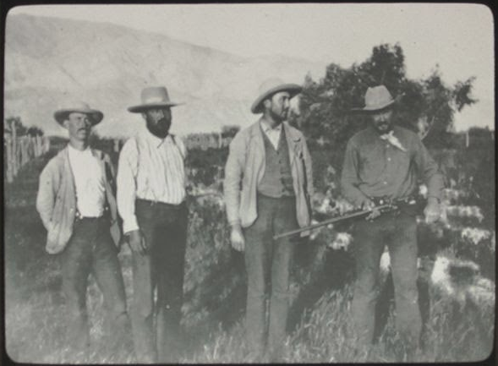
Early Naturalists of Mammalogy
ca. 1919 – Death Valley

Slide 11
Early Naturalists of Mammalogy
ca. 1919 – Death Valley
Vernon
Bailey
(more later)

Slide 12
Early Naturalists of Mammalogy
ca. 1919 – Death Valley
Hart
Merriam
(recognize the name?)

Slide 13
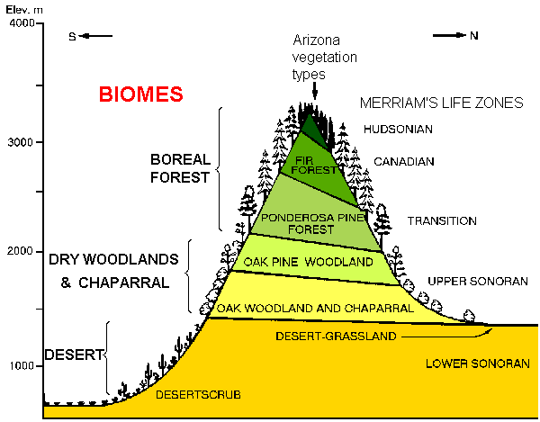
Merriam’s Life Zones
Grand Canyon
Phoenix

Slide 14
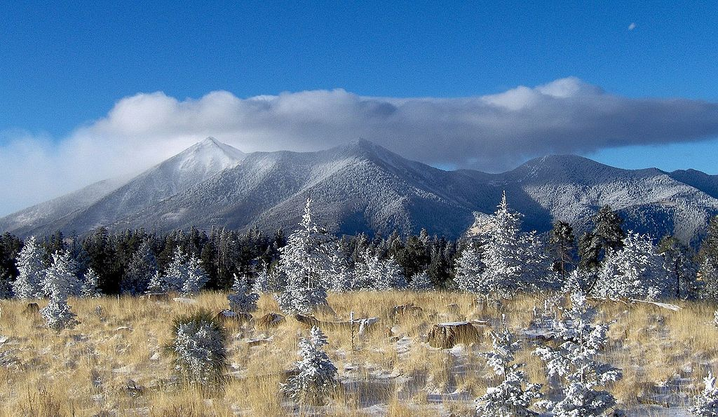
San Francisco Peaks, Northern Arizona

Slide 15
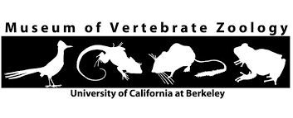
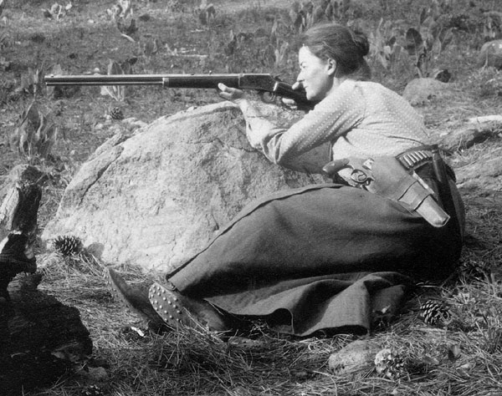
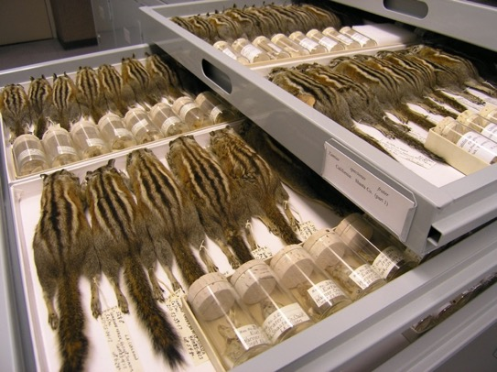
Annie Alexander
Founded MVZ in 1909

Slide 16
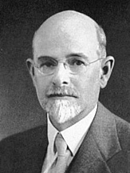
”At this point I wish to emphasize what I believe will ultimately prove to be the greatest value of our museum. This value will not, however, be realized until the lapse of many years, possibly a century, assuming that our material is safely preserved. And this is that the student of the future will have access to the original record of faunal conditions in California and the west, wherever we now work.”
-- Joseph Grinnell
(ca. 1910)
Curator of Mammals
Museum of Vertebrate
Zoology, Berkeley,
1908-1938.

Slide 17
”At this point I wish to emphasize what I believe will ultimately prove to be the greatest value of our museum. This value will not, however, be realized until the lapse of many years, possibly a century, assuming that our material is safely preserved. And this is that the student of the future will have access to the original record of faunal conditions in California and the west, wherever we now work.”
-- Joseph Grinnell
(ca. 1910)
Curator of Mammals
Museum of Vertebrate
Zoology, Berkeley,
1908-1938.

Slide 18
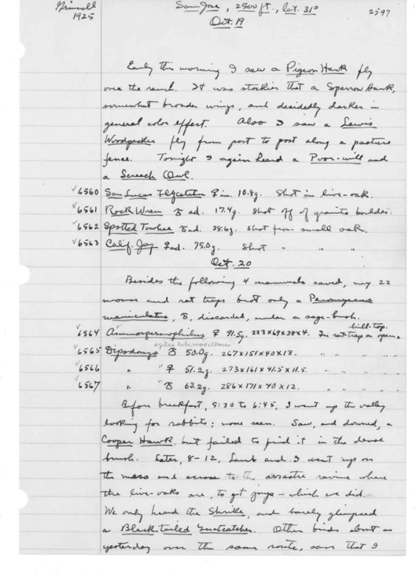
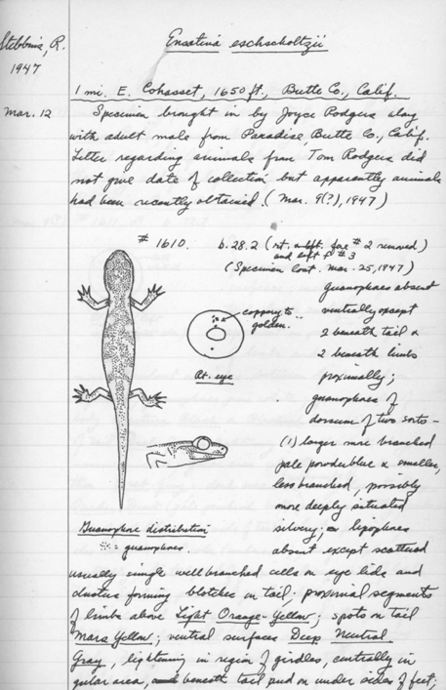

Slide 19
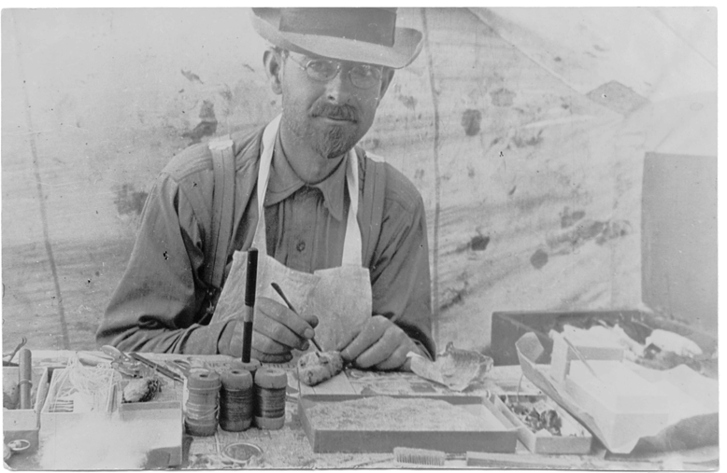
Joseph Grinnell
Grinnellian Niche – “environmental conditions limit a species distribution”
The Grinnell Method – Further standardized field note format and specimen preparation

Slide 20
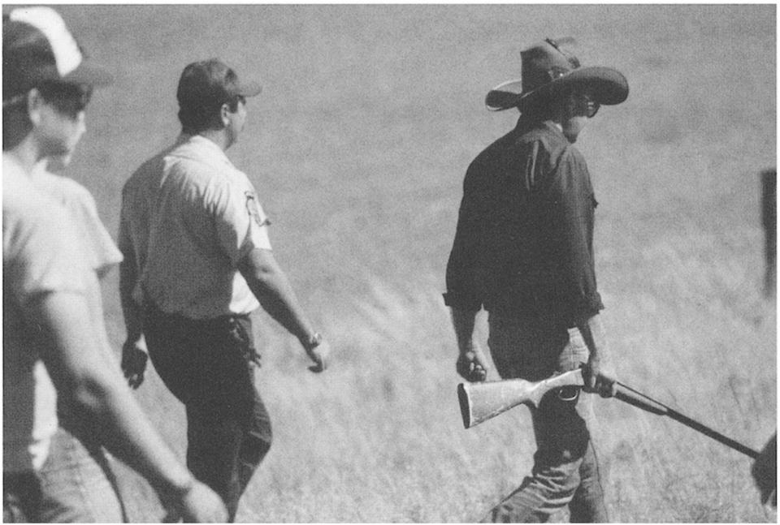
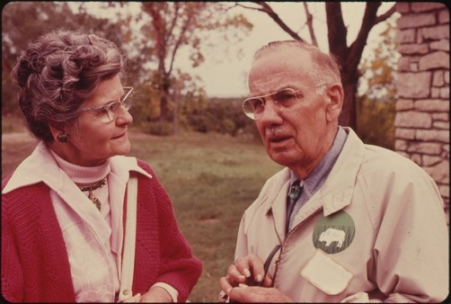
Mammalogy in Kansas
Jerry Choate
in 1987
- Hayes, KS
E. Raymond Hall
KU Museum

Slide 21
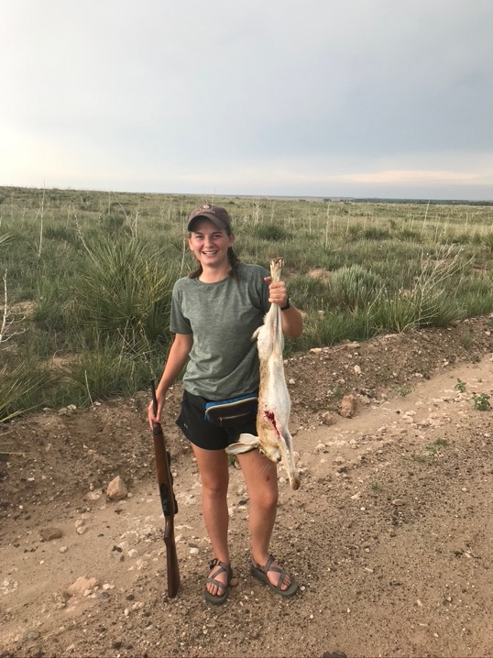
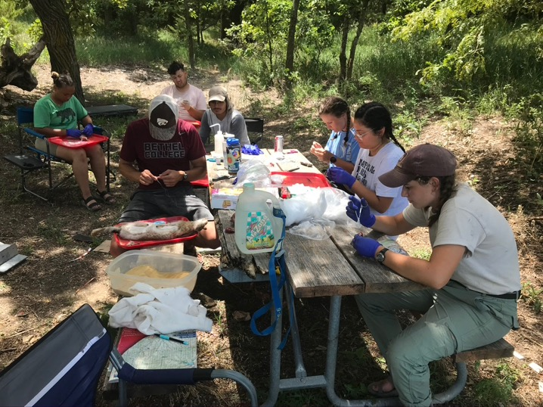
Kailey Meacham
in 2021 (34 yrs after Choate)
- Cimarron NG, KS.
Mammalogy in Kansas
Field prepping
100 years after Grinnell

Slide 22
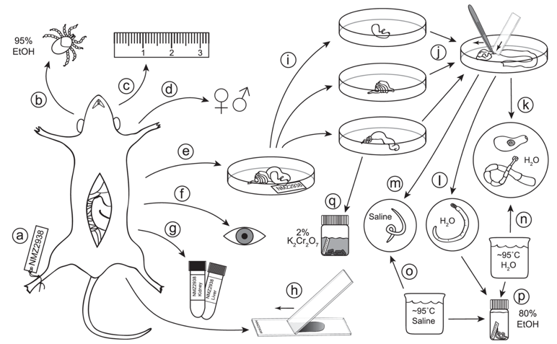

Slide 23
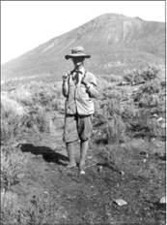
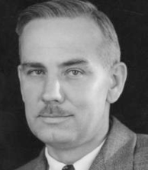
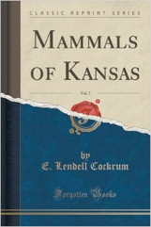
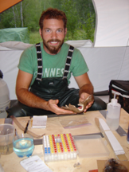
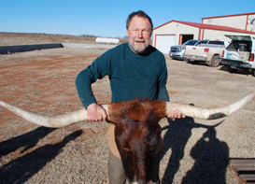
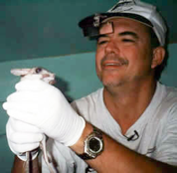
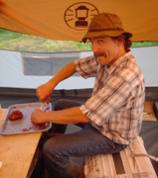
Annie Alexander – U.C. Berkeley, Museum of Vertebrate Zoology
Joseph Grinnell – U.C. Berkeley, Museum of Vertebrate Zoology
E. Raymond Hall – KU, Biodiversity Institute
E. Lendell Cockrum – University of Arizona
Robert R. Baker – Museum of Texas Tech University
Terry L. Yates – University of New Mexico, Museum of Southwestern Biology
Joseph A. Cook – UNM, MSB
Andrew G. Hope – K-State Mammal Collection…

Slide 24
The next generation

Slide 25
Early Naturalists of Mammalogy
ca. 1919 – Death Valley
Back to
Vernon
Bailey

Slide 26
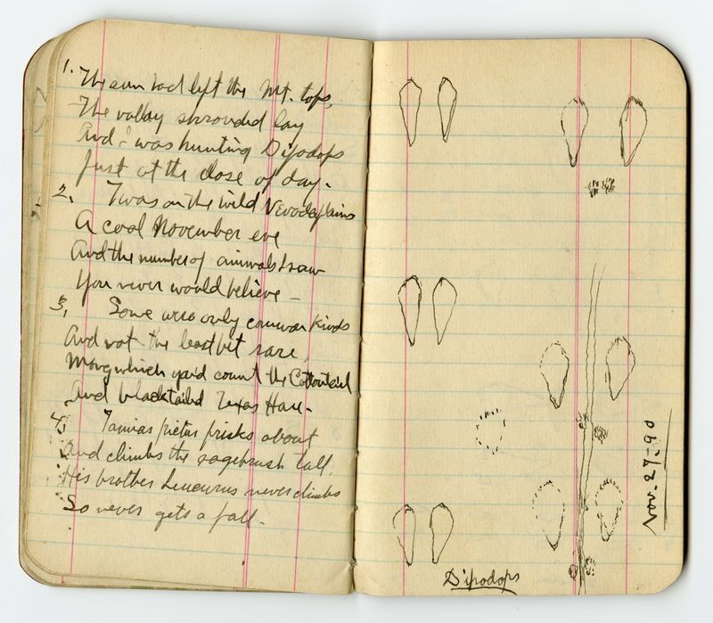
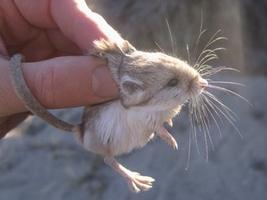
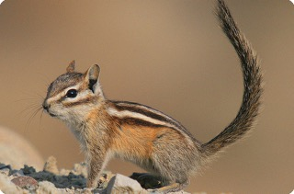
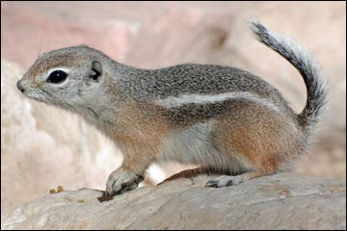

Slide 27
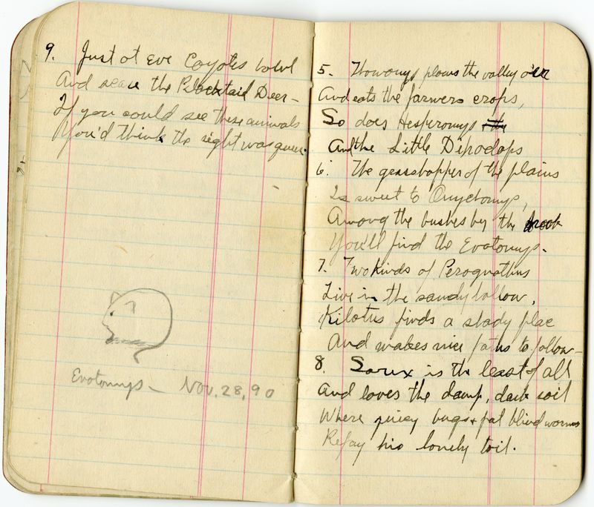
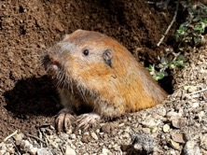
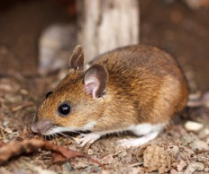
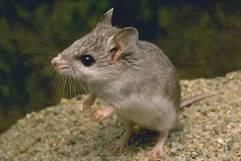
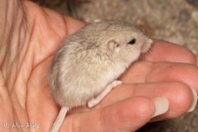

Slide 28
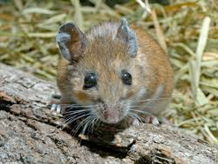
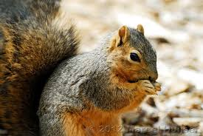
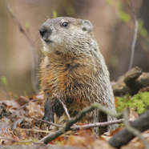
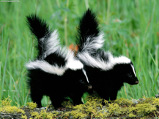
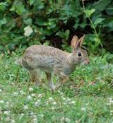
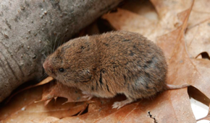
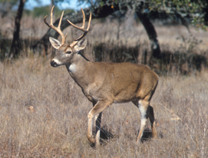
Woodland
In the trees
In the bushes
In the leaf litter, under logs
Forest edge
Underground
Daytime/Nighttime
Dawn/Dusk
Near water

Slide 29
Tallgrass Prairie
In the bushes
In tall grass, or open disturbed sites
In the litter
Underground
Daytime/Nighttime
Dawn/Dusk
Near water

Slide 30
Shortgrass Steppe
In shrubs
In the litter
Underground
Daytime/Nighttime
Dawn/Dusk
Near water

Slide 31
Mammals at Risk in KS
Black-footed ferret
Black-tailed prairie dog
Problems:
Conflict with agriculture, ranching
Complex relationship and fine balance
Disease
No genetic variation
No easy solution
Ecotourism?
Subsidies?

Slide 32
Meet Elizabeth Ann…
Cloned in 2020
DNA sample from a museum
30 years old
Retained old genetic diversity

Slide 33
Bats
Cave dwellers→ White-nose syndrome
Tree roosters→ Wind turbines
Other diseases
Human conflict
No easy solution...

Slide 34
Bats

Slide 35
Eastern Spotted Skunk
Conflict: “clean farming”
Modern industrial
Much fewer edge habitats
No easy solution…

Slide 36
Other species
Considered at risk (data deficient)
Southern bog-lemming
Southern flying squirrel
Spotted ground squirrel
Fulvous harvest mouse

Slide 37
What can we do?
Public education → awareness/support
Become a naturalist!
Observe, record, disseminate
Advance science
population ecology, community ecology, evolutionary ecology
Continue field sampling and specimen collections
Train the next generation

Slide 38
Methods for identifying mammals
Learn the major skull features.
Remainder of class: identify mammal specimens
Please handle the specimens! But, be gentle…

