Slide 1
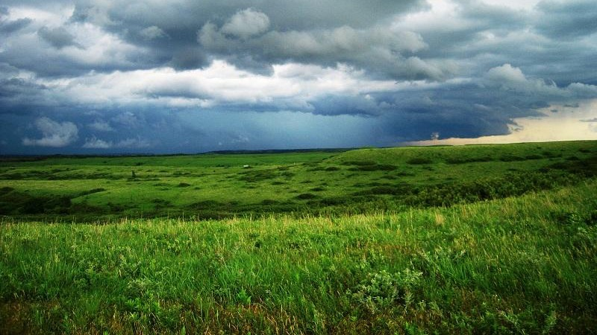
Climate Dynamics
PC: Dr. Eva Horne

Slide 2
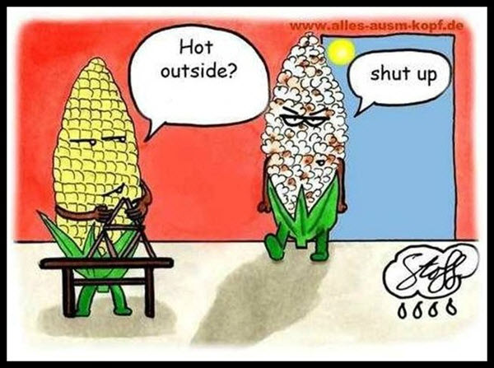
vs.
Weather
Climate
Short term conditions (minutes to days)
Temperature, precipitation, humidity, atmospheric pressure, wind, cloud cover experienced at any given point in time.
Long term average and variation of weather for a particular region (30+ years).
Long- and short-term cycles (ranging from 3 years to 100,000 years)

Slide 3
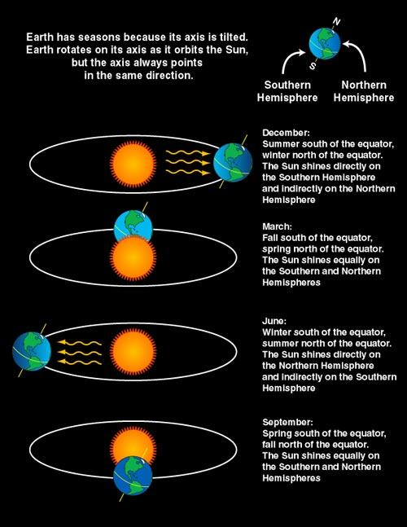
Earth’s tilt creates the seasons
Earth’s axis tilts 23.5°
Hemisphere tilts away = winter
Hemisphere tilts toward = summer
Distribution of solar radiation striking earth.
Earth’s climatic patterns are driven by:
Distribution and intensity of solar radiation
The atmosphere
Earth’s surface
Oceans
https://spaceplace.nasa.gov/seasons/en/

Slide 4
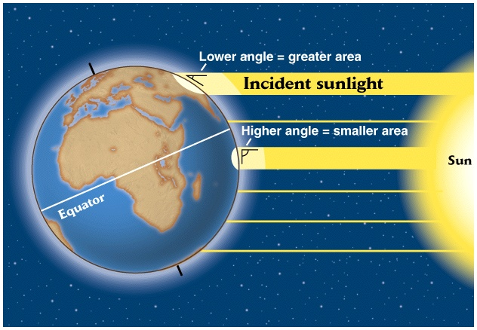
Direct solar radiation causes the tropics to be warmer than the poles
Longer path length through atmosphere
shorter path length
through atmosphere

Slide 5
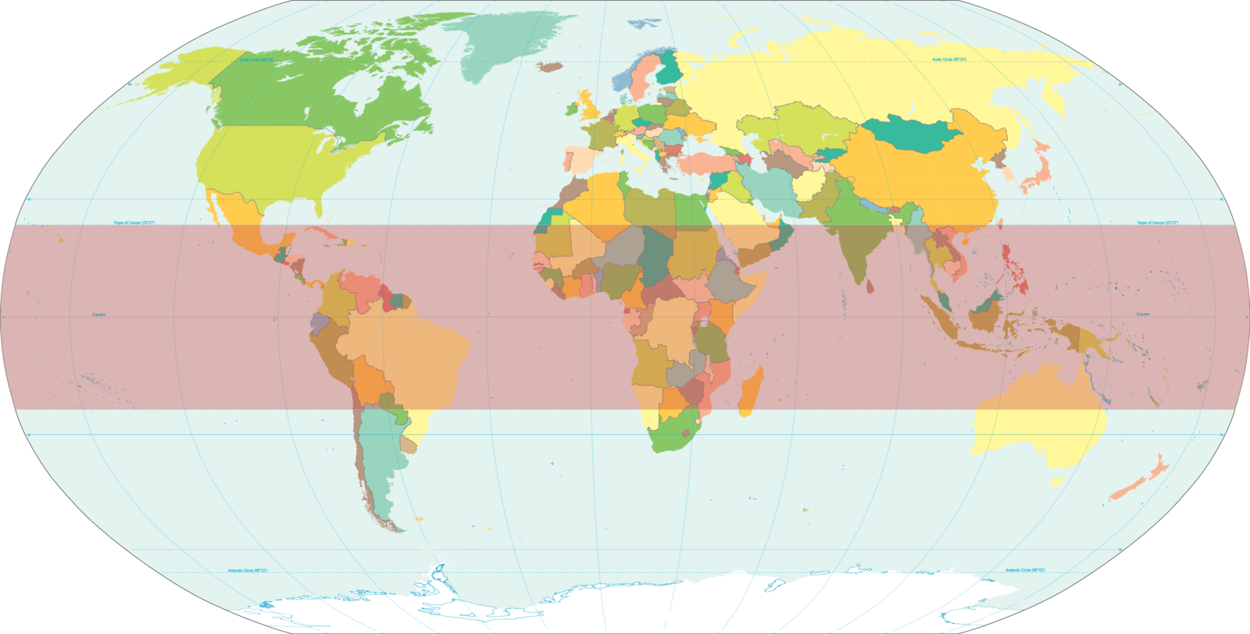
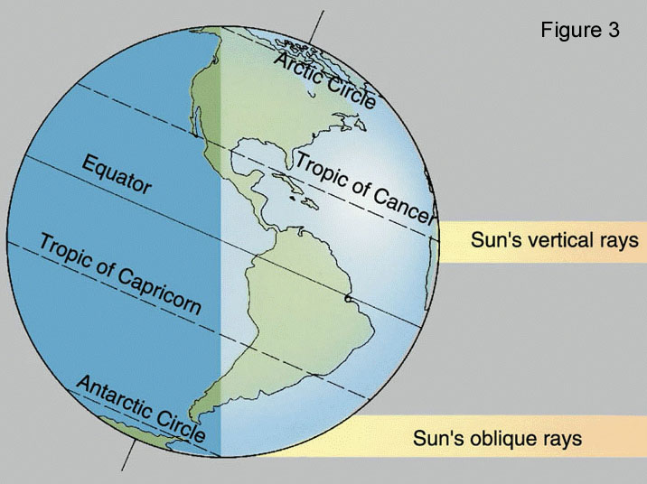
Tropics are bound to 23.5° N and 23.5° S
Tropic of Cancer
http://faculty.kutztown.edu/courtney/blackboard/Physical/21Seasons/seasons.html
Tropic of Capricorn

Slide 6
Warm
Uneven heating of Earth’s surface drives atmospheric circulation
Global circulation – redistribution of heat from the tropics to the poles via wind and ocean currents.
Warm air expands and rises = lower surface atmospheric pressure
Cool air compresses and sinks = higher surface atmospheric pressure
      Air moves from high → low atmospheric pressure (i.e. wind). Driving atmospheric circulation.
Cool

Slide 7
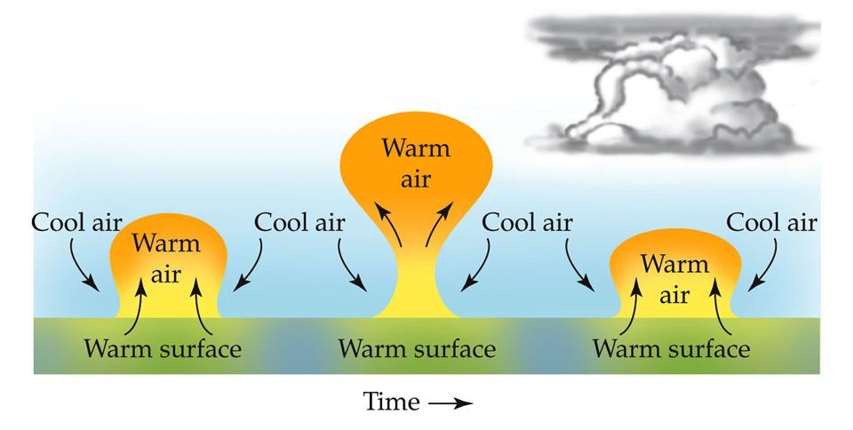
Adiabatic cooling
Temperature change due to expansion of air
As warm air rises it begins to cool and form clouds (adiabatic cooling)
Cool air follows the pressure gradient and replaces the warm air
This process is greatest at the tropics

Slide 8
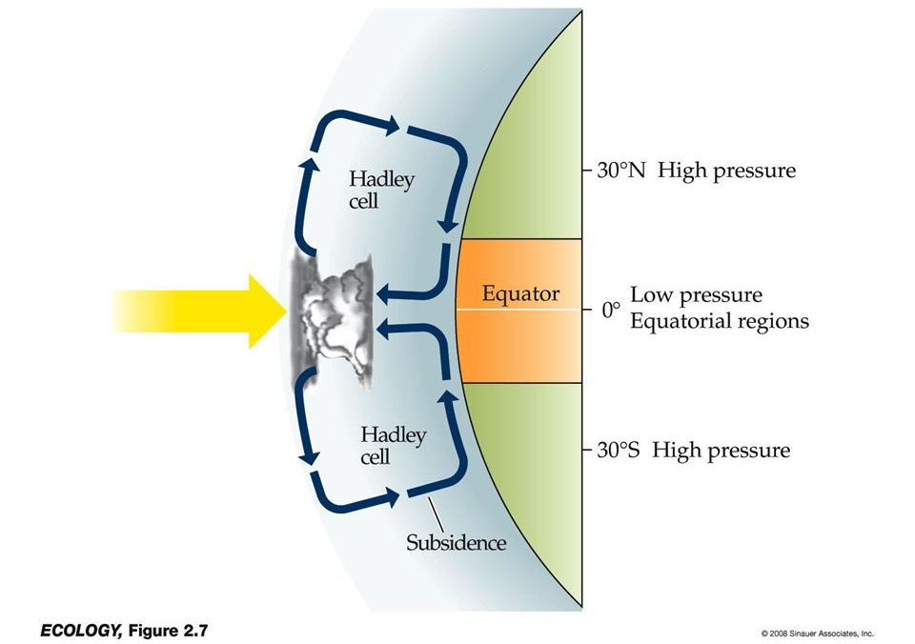
Warm air rises in the tropics and moves toward the poles (creating a zone of low pressure).
As air expands, it cools and water vapor condenses, forming clouds
As air moves toward the poles, it cools and begins to sink (creating a zone of high pressure).
because of sinking air
Air moves from high pressure to low pressure, completing the circulation.
because of rising air
Intertropical Convergence Zone
Winds from the north and south converge
because of sinking air

Slide 9
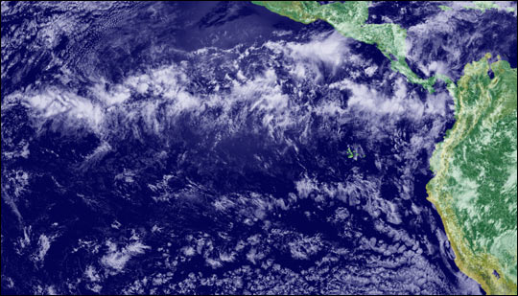
Cloud formation along the Intertropical Convergence Zone (ITCZ)
The rising and adiabatic cooling of air in the tropics forms a region of constant cloud formation (ITCZ). Creating an area of frequent rainfall.
ITCZ

Slide 10
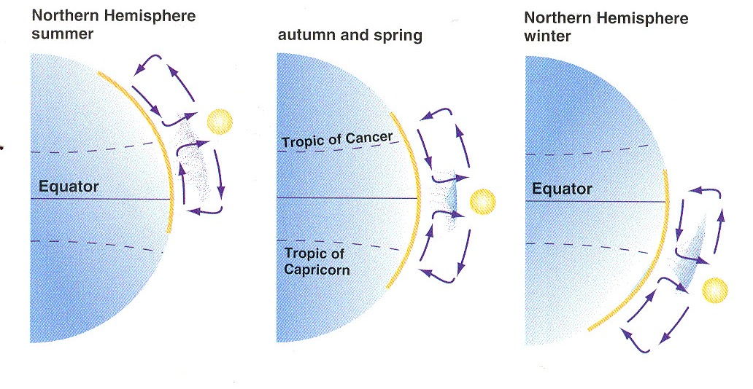
Movement of the ITCZ affects seasonality of sub-tropical ecosystems
Direct solar radiation determines location of ITCZ

Slide 11
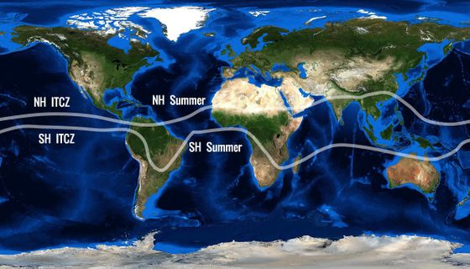
Location of the ITCZ shifts with the seasons causing wet and dry seasons in the tropics and subtropics.
ITCZ band in July
ITCZ band in January

Slide 12
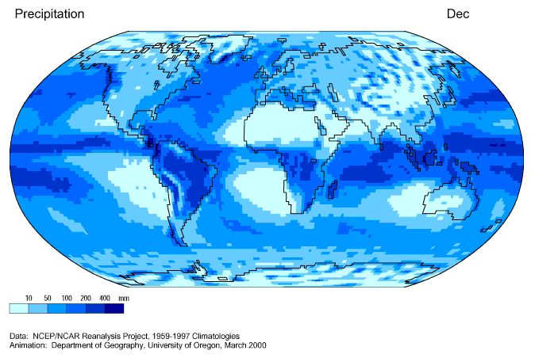

Slide 13
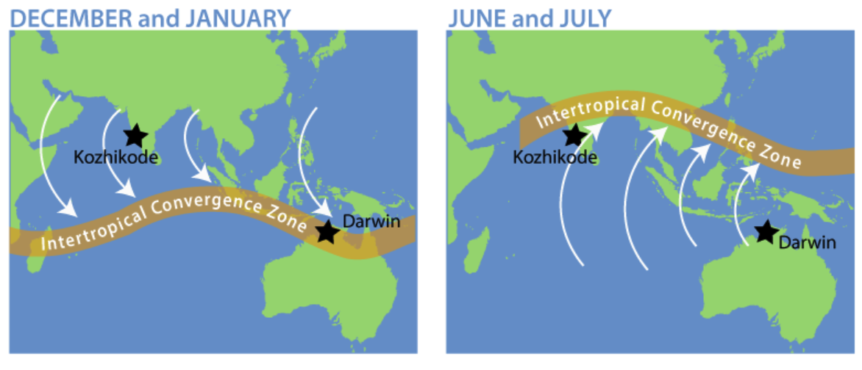
Monsoons
Change in winds and rains that drive wet and dry seasons
H
L
L
H
University Corporation for Atmospheric Research

Slide 14
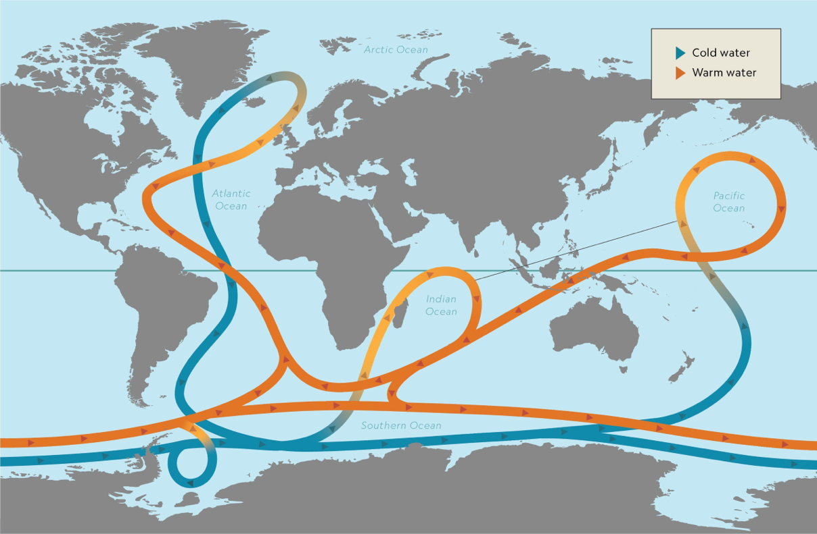
Global conveyor belt
NW Europe is warmed by currents!
Oceans account for ~40% of heat exchange from tropics to poles
Water warmed in the tropics moves north, cools, and sinks.
Water is more resistant to temperature change than air.

Slide 15
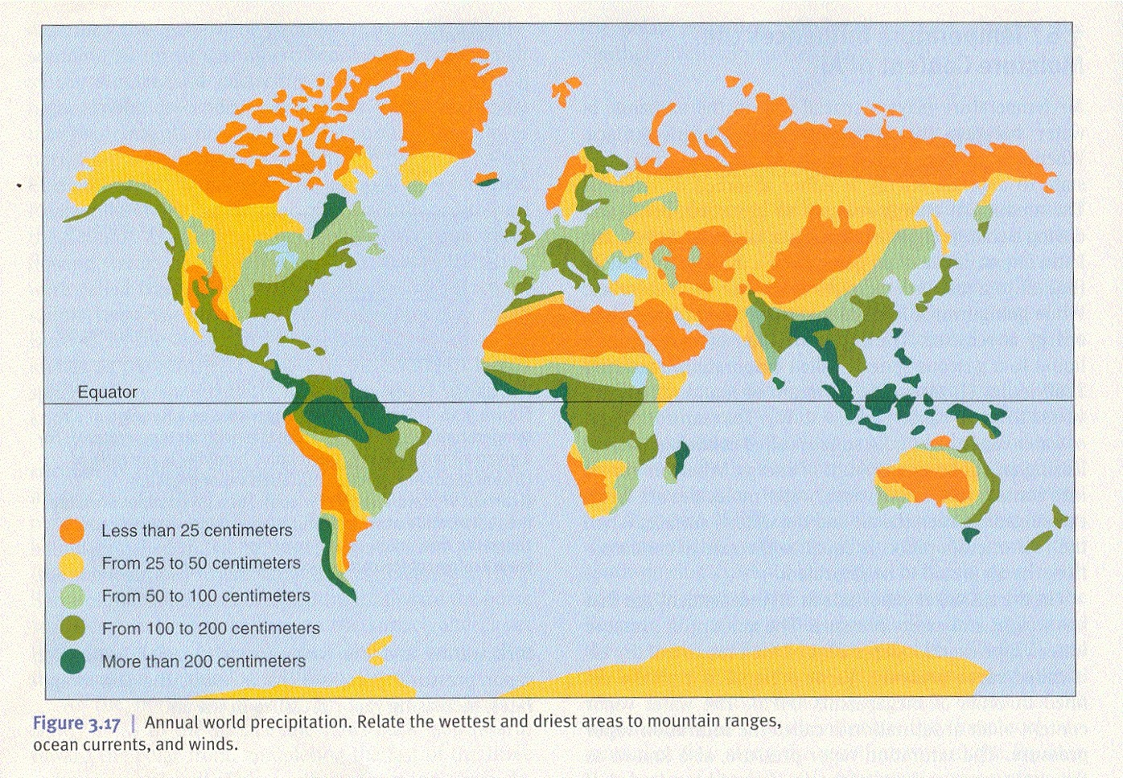
Atmospheric and oceanic circulation patterns lead to climatic zones
90ºN
Subtropical
high press.
60ºN
Hot Deserts
30ºN
ITCZ
Wet Tropical Forest
0º
Hot Deserts
30ºS
Subtropical
high press.
60ºS
90ºS

Slide 16
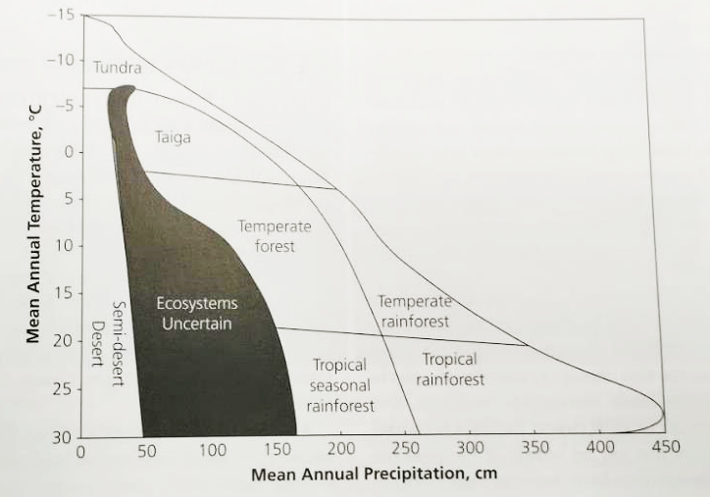
What does this all mean for grasslands?
Grasslands fall into the “Ecosystems Uncertain.”
Grasslands are not solely determined by climate (think large mammals and fire).

Slide 17
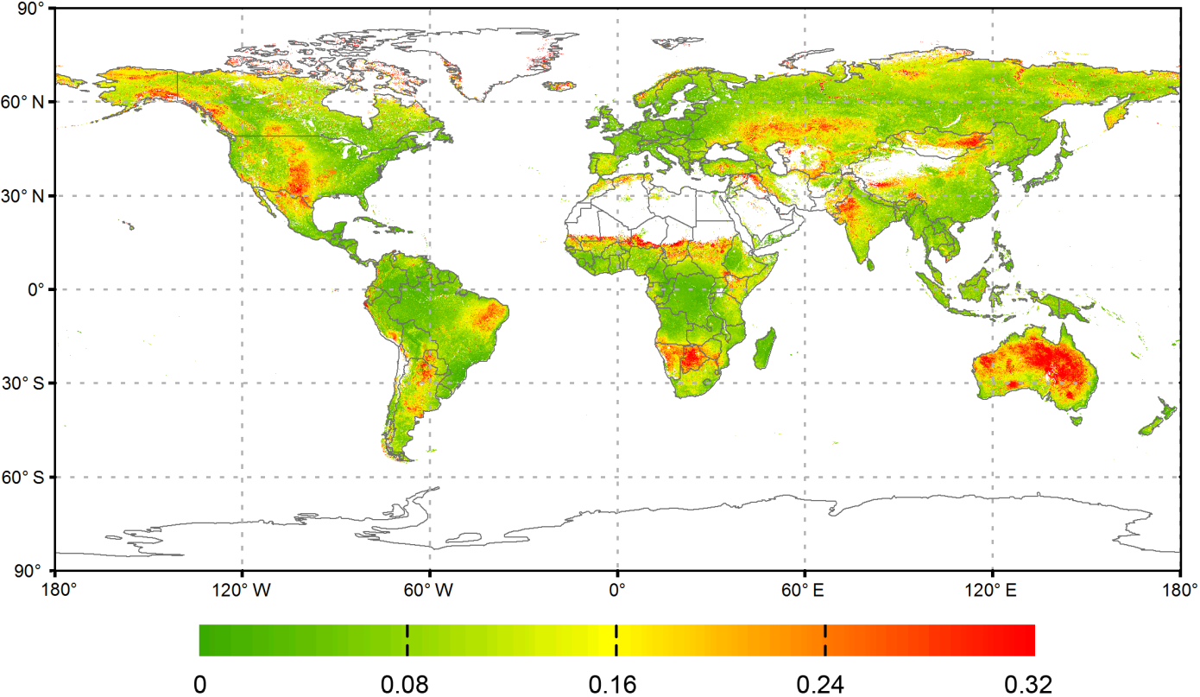
Inter-annual variability in productivity is high in grasslands
The interannual variability (i.e., the coefficient of variation or CV) of annual gross primary productivity (GPP) over the period 2000–2014 from the MODIS GPP product (MOD17A3).
Xiao et al. 2016. Biogeosciences, 13, 3665–3675

Slide 18
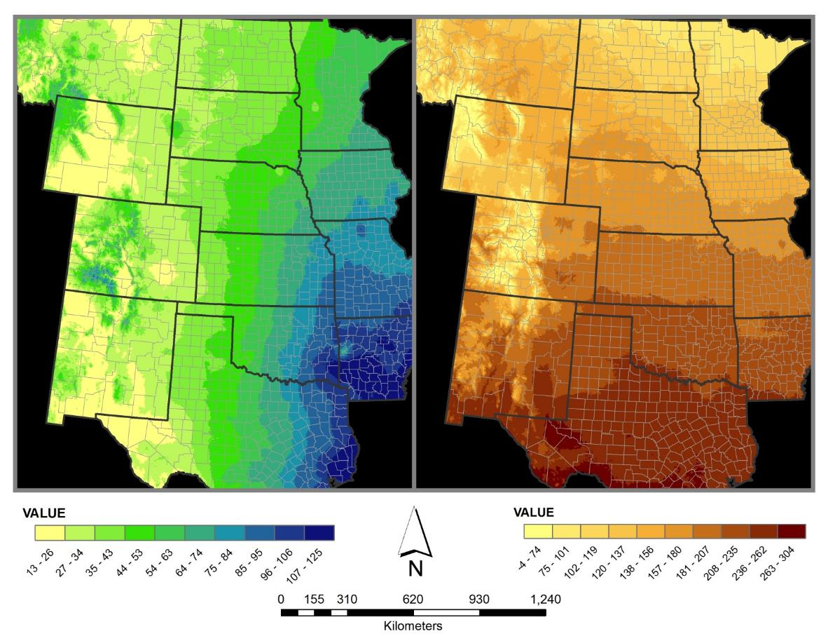
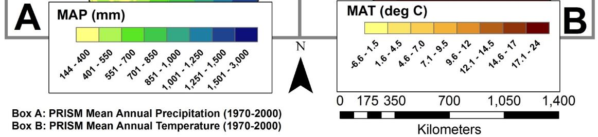
Central US precipitation and temperature gradients

Slide 19
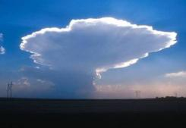

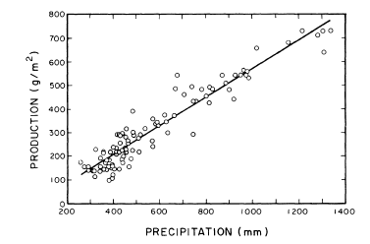
Regional precipitation gradients drive patterns of plant productivity
Precipitation vs. productivity across the Central US
Sala et al. 1988

Slide 20
Droughts have been historically important & frequent in Central US grasslands
6
1951 Flood
(53.1” rain & 50.2ºF)
1993 Flood
(52.4” rain & 50.9ºF)
4
Extreme rainfall
2
Palmer drought severity index
0
-2
Moderate drought
1934 drought
(22.8” rain & 56.4ºF)
-4
1956 drought
(21.5” rain & 54.5ºF)
Extreme drought
2012 drought
(23.2” rain & 57.3ºF)
-6
1895
1900
1905
1910
1915
1920
1925
1930
1935
1940
1945
1950
1955
1960
1965
1970
1975
1980
1985
1990
1995
2000
2005
2010
NOAA National Centers for Environmental information, Climate at a Glance: National Mapping, https://www.ncdc.noaa.gov/cag/

Slide 21
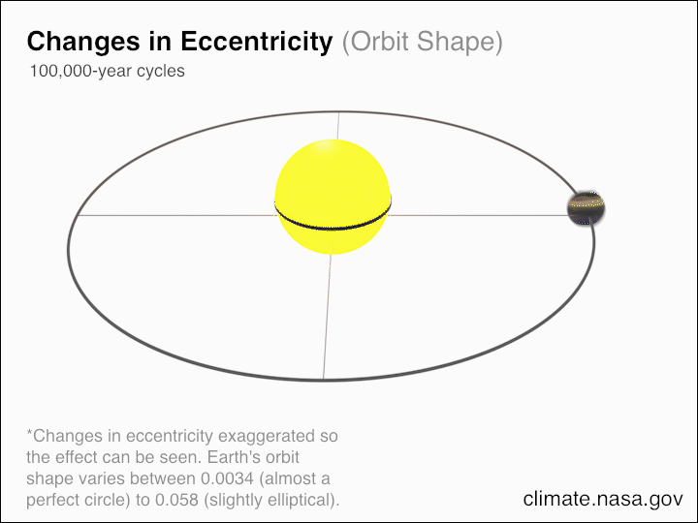
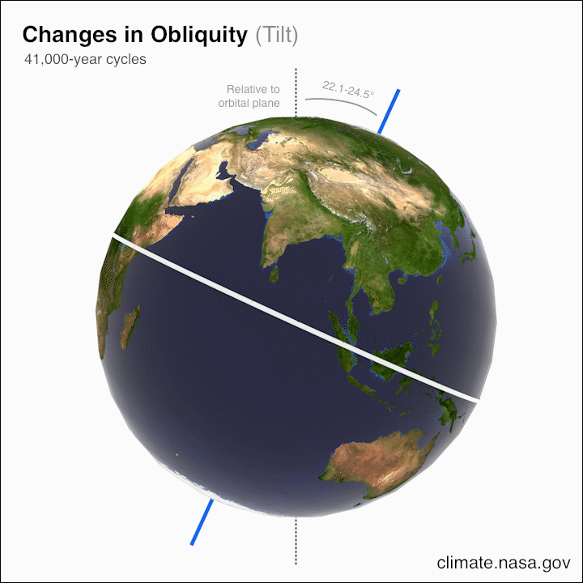
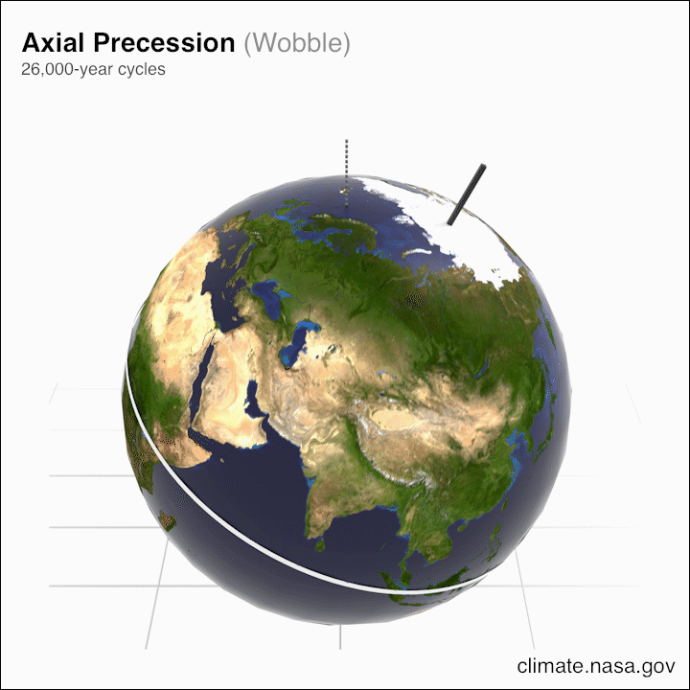
Natural variation in climate
Changes in the intensity and distribution of solar radiation
Credit: NASA/JPL-Caltech
Notes:
Because earth’s tilt, rotation, and revolution are so important for climate patterns, you can imagine that a shift in any of these results in a shift in climate.
These fluctuations influence the amount of solar radiation the Northern Hemisphere receives in the summer. Less heat = less ice melt 🡪 Ice age.
Milankovitch Cycles (100,000 years)
Regional warm and cold periods (200-1,500 years)
El Nino (3-7 years) and La Nina
Pacific Decadal Oscillation (25-45 years)
Atlantic Multi-decadal Oscillation (65-85 years)
https://www.youtube.com/watch?v=iA788usYNWA

Slide 22
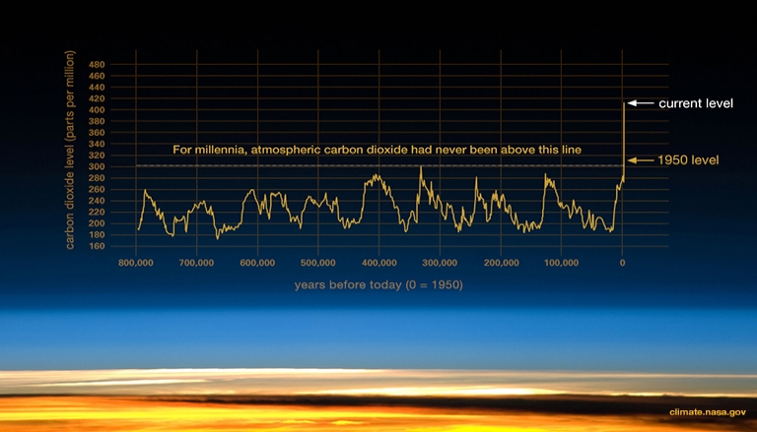
How will a changing climate affect grasslands?

Slide 23
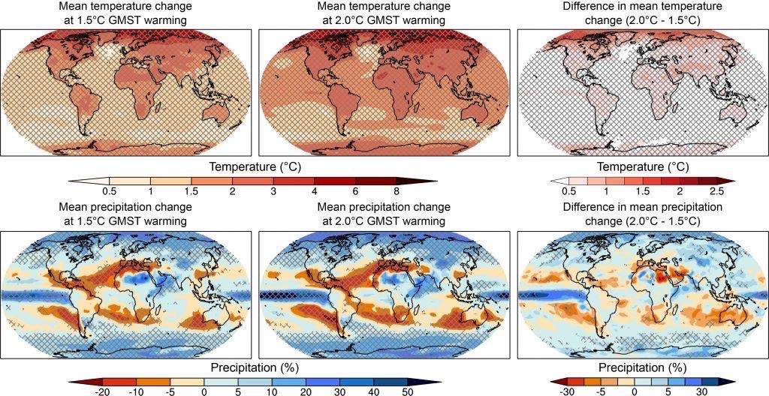

Slide 24
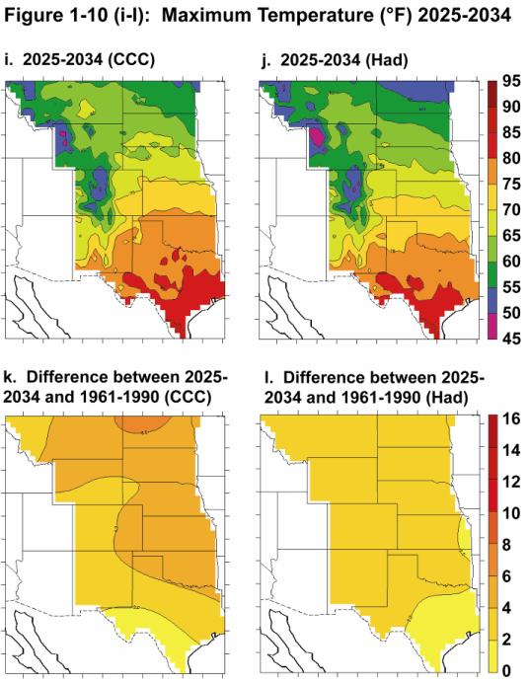
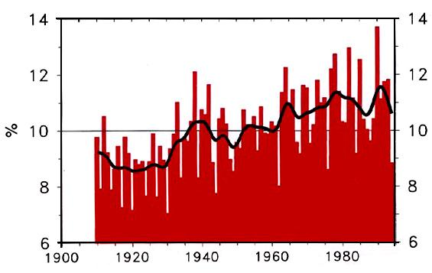
Two important climate change predictions for the US Central Plains…
Max and min temps are expected to increase
2. Increased rainfall variability and frequency of extreme events
Proportion (%) of rainfall in “extreme events”
Proportion of total rainfall in the US from large (>5 cm) rainfall events

Slide 25
14.4
Temperature
13.3
ºC
12.2
11.6ºC
11.1
1900
1910
1920
1930
1940
1950
1960
1970
1980
1990
2000
2010
2020
Year
NOAA National Centers for Environmental information, Climate at a Glance: National Mapping, https://www.ncdc.noaa.gov/cag/

Slide 26
Precipitation change
Inherent variability plus directional change
Rahmani et al. 2015 Int. J. Climatology
Fig 2: Total annual rainfall trend in KS averaged for 23 stations (1890-2011)

Slide 27
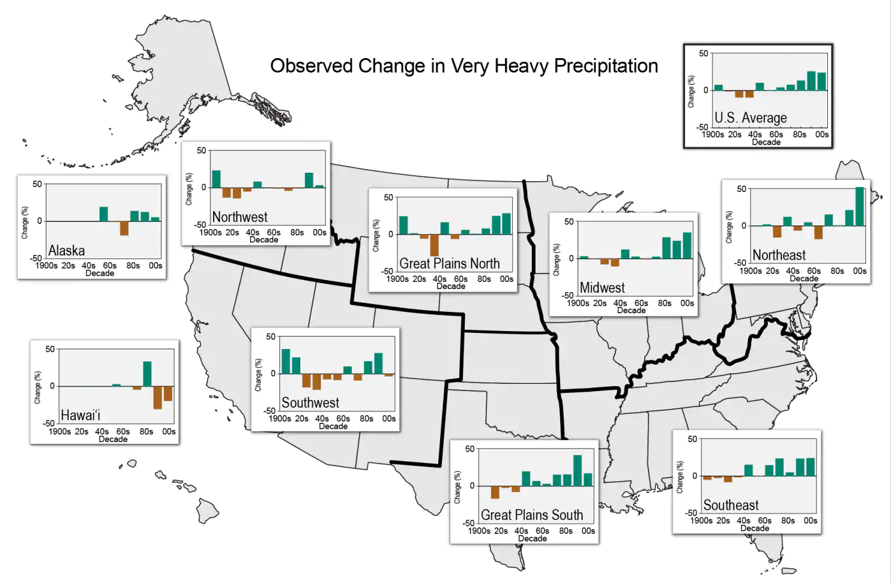
National Climate Assessment 2014
Notes:
Calculated from 1901-2010 as the heavies rainfall in daily events (top 1%). This graph represents the percent change of rainfall (heavy anomalies
More warming = increased likelihood of heavy preip events.

Slide 28
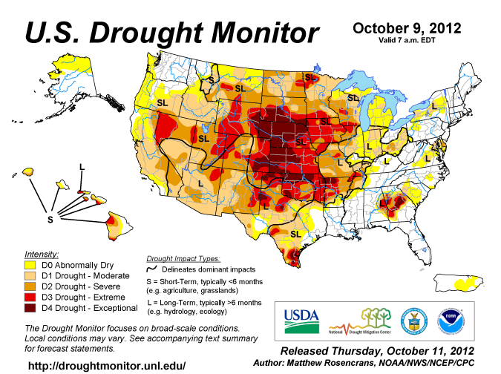
Droughts are forecast to become more frequent & severe in the Central US grassland region

Slide 29
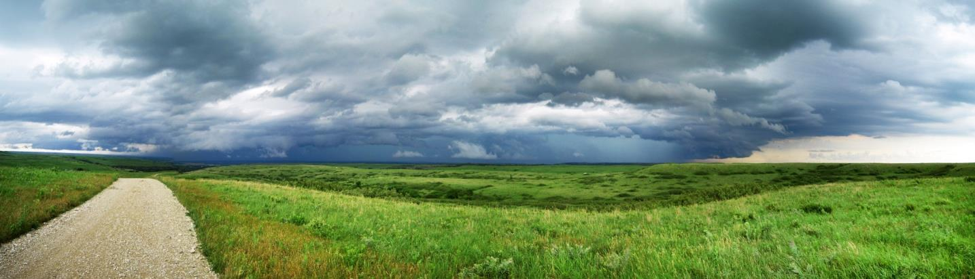
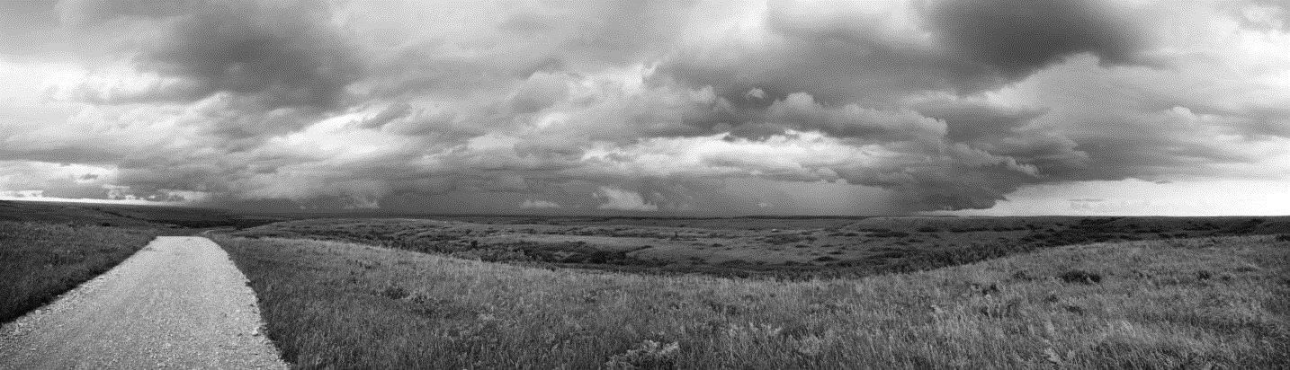
photo by: Eva Horne
CO₂
Precipitation
Transpiration / Evaporation
Runoff
Infiltration
Temperate grassland hydrological cycle reflects rainfall amount and timing
Future ?
increased event sizes, decreased frequency, altered seasonality, increased air temperatures
CO₂
Precipitation
Evaporation /
Transpiration
Runoff
Infiltration
Notes:
Temperate grasslands tend to recharge soil moisture during the dormant season when ET is low, and plants are not using water
Runoff tends to be low when vegetative cover is present and transpiration is the dominant pathway for water recycling.
In most forecast climate change scenarios, annual rainfall amount is similar, but rainfall frequency decreases. This means fewer, larger events with likely less infiltration, with more runoff out of the system. This likely leads to decreased soil moisture and water available to vegetation. Combined with increased air temperatures, drier soils lead to more bare space and a shift in the ET ratio with greater losses due to evaporation and more energy partitioning to sensible rather than latent heat.

